Slide 1

Divider slide
2020-21 TRS-ActiveCare Employee Health Benefits

Slide 2
Presentation agenda
TRS-ActiveCare Program Highlights
  Activate Your Health
  NEW: TRS-ActiveCare Primary Plan
  Benefit Enhancements
TRS-ActiveCare Medical Benefits through BCBSTX
  Rates and Benefits
  Understanding Your Deductible
  Member Health and Wellness Resources
TRS-ActiveCare Pharmacy Benefits through CVS Caremark
Regional HMO Offering
  Central Texas – Scott and White Care Plans HMO
  West Texas – Blue Essentials HMO
  South Texas – Blue Essentials HMO
bswift Enrollment Update
  Who is Eligible to Enroll?
  Enrollment Support
Notes:
Note to Presenter – If your district is not an HMO eligible region, we recommend you remove the HMO information from this list and the HMO slides.
TRS-ActiveCare Program Highlights – We’ll start today’s meeting with an overview of new benefits that have been added the TRS-ActiveCare program.
TRS-ActiveCare Medical Benefits through BCBSTX Next, we’ll take a deep dive on the new medical plan benefits made available through Blue Cross and Blue Shield of Texas.
TRS-ActiveCare Pharmacy Benefits through CVS Caremark – Then we will discuss the pharmacy benefits for each individual ActiveCare plan
Regional HMO Offerings – Next, I will share the HMO plan that’s available to you and the plan feature.
Bswift Enrollment Update – Lastly, we will discuss enrollment. While this years Annual Enrollment will be passive, there is important information you need to know if you do not ACTIVELY choose a plan.

Slide 3
What Is TRS-ActiveCare?
Established and signed into law in 2001
(Chapter 1579, Texas Insurance Code)
A statewide health care benefits program for employees
of school districts, charter schools, regional educational
service centers and other educational districts
Law authorizes funding levels to help employees pay
for coverage
Notes:
What is TRS-ActiveCare?” It’s the statewide health care benefits program for public education employees. It was established by the Texas Legislature and signed into law. An important aspect of the law is that it authorizes funding levels to help employees pay for coverage. The program effective date was Sept. 1, 2002. Fully insured HMO options were added to the program in 2003.

Slide 4





Your Health plan administrators
Notes:
TRS is excited to provide medical and pharmacy benefits to you and your family through the TRS-ActiveCare program. After a extensive contracting process, starting Sept. 1, 2020, the program will be administered by Blue Cross and Blue Shield of Texas. BCBSTX will handle health and wellness programs and claims processing for the TRS-ActiveCare medical plans.
CVS Caremark will continue as the prescription drug program administrator for all the plans and bswift will begin a new independent roll as enrollment and eligibility administrator.
Scott & White Care Plan will offer an HMO plan in Central and North Texas.
Blue Cross and Blue Shield of Texas, also known as Blue Essentials, will be offering and HMO in West and South Texas.

Slide 5
Notes:
This is not an average year, over the last year TRS has met with Benefits Administrators and other districts leadership to get feedback on how they could improve the plan for you. As a result, TRS has made big changes to the plan and enhanced benefits for you.
These changes lead us to this years ActiveCare slogan – Activate Your Health. TRS wants you to feel empowered to attain your healthiest self and that starts with picking a plan option that best meets the needs of you and your family.
As we discuss the plan options, I want you to consider how you’ll use your health care this year and determine what health goals you want to meet. And when Annual Enrollment begins on [district specific Annual Enrollment date] I encourage you all to actively choose your health care plan.

Slide 6
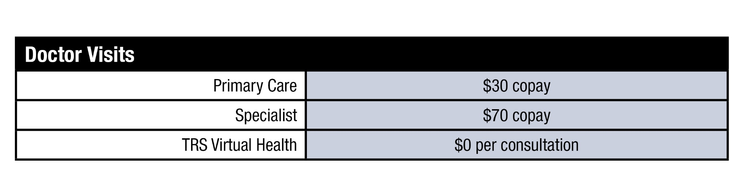
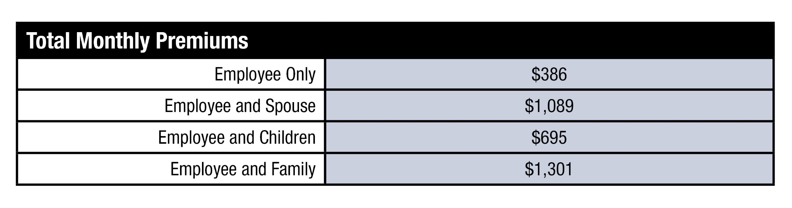
NEW TRS-ACTIVECARE PRIMARY PROVIDES
LOW PREMIUM and copays
MUST ACTIVELY ENROLL IN PLAN
*
*Rates before district/state contribution
Notes:
This year, TRS will be introducing a new lower premium plan that offers predictable copays for office visits called TRS-ActiveCare Primary.
This plan features:
Copays for primary care and specialist visits and generic medications before the deductible is met
And an integrated individual and family deductible on family tiers
Since this is a new plan, employees must actively enroll in it to receive the coverage. We’ll be sharing more details on enrollment in an upcoming slide.

Slide 7
TRS-ActiveCare: Benefit Enhancements
***New***
Formerly Select
Formerly 1-HD
TRS-ActiveCare Primary
Copays for PCP and specialists (no deductible)
TRS-ActiveCare Primary+
Lowered copay for therapies to $30
TRS-ActiveCare HD
Individuals only need to meet individual deductible on tiers with families
Individuals only need to meet individual deductible on tiers with families
Lower ind. & family deductible
Lowered individual and family MOOP
Broad, statewide network
Primary compared to current version of TRS-ActiveCare 1-HD. No changes to AC-2 benefits. Additional details available in plan highlights document.
Notes:
Before we get started, I want to highlight some benefit enhancements that were made to the TRS-ActiveCare plans. TRS spent the past year meeting with district leadership to discuss ways to enhance benefits for you. They’ve made
TRS is offering a new plan called TRS-ActiveCare Primary. This new plan will offer a lower deductible for individual and family plans, predictable copays for office visits and specialty care and will have that individual deductible for plans with dependents.
The TRS-ActiveCare Primary+ plan, which is currently known as Select, will have a decreased maximum out-of-pocket, lower copays for physical therapy, and no copay for inpatient facility, high-tech radiology, outpatient surgery and non-free standing ER. This plan will also have that integrated deductible for family plans. They also added a statewide network to the plan.
TRS-ActiveCare HD, currently known as 1-HD, will also have that individual deductible for plans with dependents.
There will be no changes to ActiveCare 2 and please remember this plan is closed to new enrollees.

Slide 8
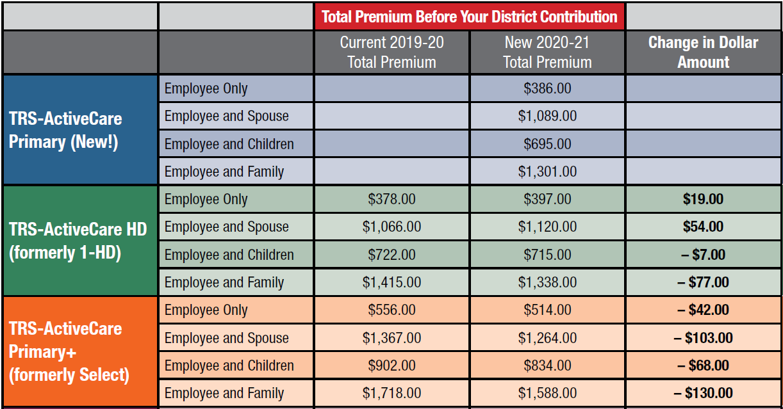
lower premiums in family tiers
Notes:
TRS knows how important it is to offer comprehensive coverage to you and your family. As you see here, in this next plan year, those on family plans will see a reduction in premium cost. TRS was able to achieve lower premiums in most of the plan tiers by up to 8%.
Later on in the presentation I will share a slide that shows our district specific premium costs.

Slide 9
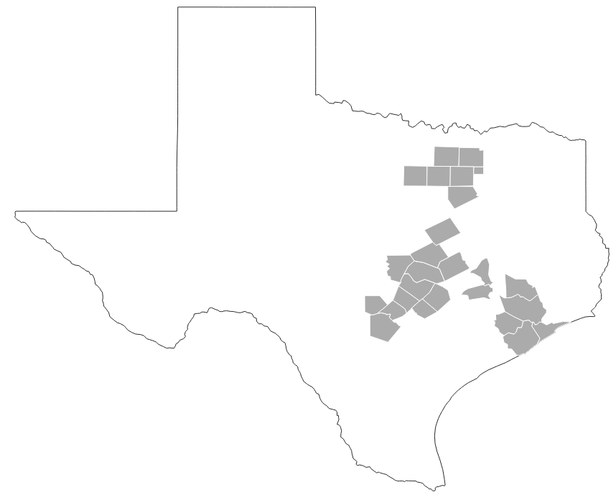
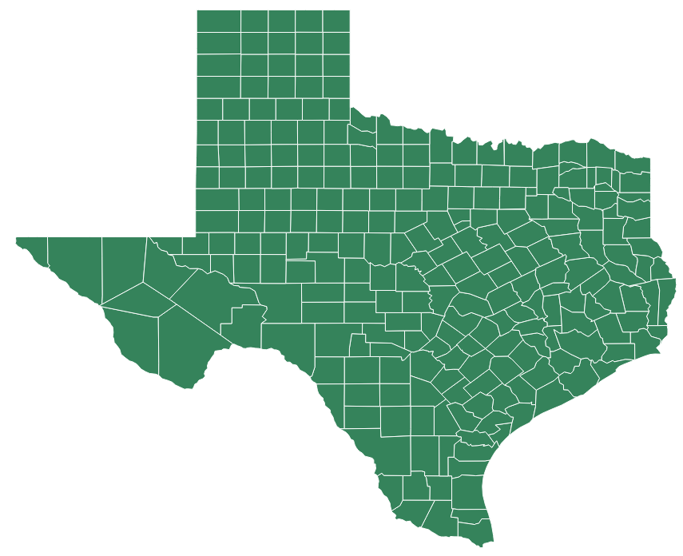
TRS-ActiveCare Primary+: The New Select
Current Select ACO Regions
Statewide Network in New Primary Plans
Members Can Access Providers Only Within Their Region
Notes:
Another enhancement that TRS made to the plans is removing the Accountable Care Organizations from the TRS-ActiveCare Select plan.
The new Select plan, TRS-ActiveCare Primary+, will have access to Blue Cross and Blue Shields broad statewide network so participants won’t have limitations on the providers they see.
This statewide network will also be available to participants on the new ActiveCare Primary plan.

Slide 10

PCP Requirement for Primary Plans
PCP’s are required for TRS-ActiveCare Primary and Primary+, but they’re also important factors in our participants health.
PCP’s can help…
Achieve Health Goals
Coordinate Specialist Care
Advocate for Care
Notes:
The two new plans, ActiveCare Primary and ActiveCare Primary+ both require a PCP in order to enroll into the plan.
PCP’s are an important part in managing the health and wellness of their patients. They’re able to help participants achieve health goals, make suggestions to improve health, coordinate care with their specialists and advocate for what treatment is best for them.

Slide 11
Annual enrollment
July 15 – Aug. 21
Current TRS-ActiveCare Plan | Plan your employee will be enrolled in on Sept. 1, 2020 if no action is taken
TRS-ActiveCare 1-HD | TRS-ActiveCare HD
TRS-ActiveCare Select | TRS-ActiveCare Primary+ (PCP requirement)
TRS-ActiveCare 2 | TRS-ActiveCare 2
First Care Health Plan or Scott and White Health Plan (West Texas) | Blue Essentials (West Texas)
Scott and White (Central and North Texas) | Scott and White (Central and North Texas)
Blue Essentials (South Texas) | Blue Essentials (South Texas)
You will have to actively enroll in the NEW: TRS-ActiveCare Primary plan.
Both ActiveCare Primary and Primary+ require a PCP.
Notes:
[BA MAKE EDIT TO SLIDE TO INPUT YOUR AE DATES. TRS AE IS JULY 15-AUG. 21 ]
Annual enrollment will take place from July XX – Aug XX.
Like in the past few years, this years Annual Enrollment will be passive.
This passive enrollment means if you does not take action, you will be automatically enrolled into a plan similar to one you are currently enrolled in and you miss the opportunity to enroll in that new TRS-ActiveCare Primary plan.
This table reflects the plan you’ll be enrolled into if you do not take action.
This is especially important if you are currently in the ActiveCare Select plan. If you do not take action during Annual Enrollment this summer, you will be enrolled in the TRS-ActiveCare Primary+ plan which requires a PCP.
There have also been changes to the HMOs. Participants in Llano and San Saba county will now be apart of the West Texas HMO region and have Blue Essentials are their HMO option next year.
So I encourage you to review your plan options and actively enroll in a plan that will best meet your needs.

Slide 12

COVID-19 TRS-Activecare Resources
Waived cost for diagnostic testing
Waived inpatient coverage for treatment
Free delivery of prescriptions
Early refills for maintenance medications
Crisis Response Lines
Expanded 24/7 Aetna Nurse Line
Resources for Living toolkit
Find more information:
trs.texas.gov/Pages/news_coronavirus.aspx
Notes:
Before we discuss the medical benefits, TRS wants to make sure you’re aware of several enhanced benefits that have been made available through Aetna and CVS under their TRS-ActiveCare plan during the COVID-19 pandemic.
TRS is waiving costs for all diagnostic testing of COVID-19 for patients who meet CDC guidelines
They’re waiving inpatient coverage for COVID-19 related treatment at both in-network and out-of-network facilities
Waiving cost for all telemedicine visits through 1) TRS Virtual Health powered by Teladoc, and 2) in-network providers who deliver virtual care, such as live video conferencing through June 4.
You can get free home delivery of all prescription medications and those on maintenance medications can get early refills before their 30-day prescription is up.
They have setup crisis response lines for participants who may be experiencing anxiety related to COVID-19
Expanded 24/7 access to the Aetna Nurse Medical Line.
Resources for Living toolkit with materials specifically developed for members experiencing anxiety related to COVID-19.

Slide 13
Medical Benefits
Notes:
Hello my name is_______ and I am the TRS District Ambassador for region(s) ______. I represent BCBS and provide support to your district’s Benefits Administrator whether its regarding general plan information and education or attending health fairs and presentations such as this one. ​
(Insert couple sentences from personal bio or tie in to region)
​
This year is not just like any other year when it comes to annual enrollment. There are lots of exciting changes and reasons to be truly active in choosing the best health plan/coverage for you and your family. Get ready to ACTIVATE YOUR HEALTH!

Slide 14
Employee Monthly Costs
STATEWIDE PLANS | TRS-ActiveCare Primary (New) |  |  | TRS-ActiveCare Primary+ (New)
 | Full Premium | State & District Contributions | Your Premium | Full Premium | State & District Contributions | Your Premium
Employee Only | $386 | -$XX | $XX | $514 | -$XX | $XX
Employee and Spouse | $1,089 | -$XX | $XX | $1,264 | -$XX | $XX
Employee and Children | $695 | -$XX | $XX | $834 | -$XX | $XX
Employee and Family | $1,301 | -$XX | $XX | $1,588 | -$XX | $XX
Notes:
Note to BA: Please fill in your district’s applicable district contribution before presenting to your employees.
Follow these simple steps to help employees better understand the premium amount they will pay:
Identify the premium amount based on the desired plan and type of dependent/family coverage needed.
From this amount, subtract both the state contribution amount and the district contribution amount shown in red.
The resulting amount will reflect what you can expect your monthly premium amount to be.
Speaker: Here is a table for you to better understand what your premium would be (after state/district contributions) for you or your family if selecting one of the statewide plans.

Slide 15
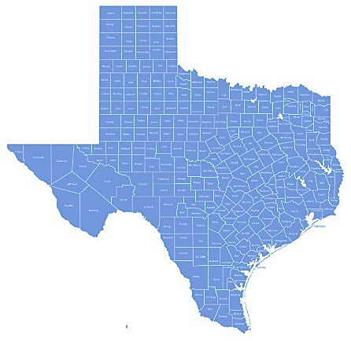
PLANS ON THE STATEWIDE NETWORK
Benefit | TRS-ActiveCare Primary New Plan |  | TRS-ActiveCare Primary+ New (formerly Select)
 | In-Network | Out-of-Network | In-Network | Out-of-Network
Individual Deductible | $2,500 | N/A | $1,200 | N/A
Family Deductible | $5,000 | N/A | $3,600 | N/A
Individual Out-of-Pocket Max | $8,150 | N/A | $6,900 (-$1,000) | N/A
Family Out-of-Pocket Max | $16,300 | N/A | $13,800 (-$2,000) | N/A
Office Visit | $30 PCP Copay $70 SPC Copay | N/A | $30 PCP Copay $70 SPC Copay | N/A
Urgent Care | $50 Copay | N/A | $50 Copay | N/A
TRS Virtual Health (Medical) | Covered at 100% | N/A | Covered at 100% | N/A
Preventive Care | Covered at 100% | N/A | Covered at 100% | N/A
Inpatient Admission | 30% after ded. | N/A | 20% after ded. | N/A
Emergency Room | 30% after ded. | *Only for true emergencies | 20% after ded. | *Only for true emergencies
Free-Standing Emergency Room | $500 Copay + 30% after ded. | *Only for true emergencies | $500 Copay + 20% after ded. | *Only for true emergencies
96%
Notes:
Let’s dive in by discussing the plan highlights for the two plans that are on the physician-directed statewide network, ActiveCare Primary and ActiveCare Primary+:
The Primary plan (the new plan) has the lowest premiums and provides access to the broad, statewide network, which is curated specifically for you. We recommend that you use the provider search tool to confirm your preferred doctors are in the network.
The Primary+ plan is a simpler version of the current TRS-ActiveCare Select plan. This plan offers a lower deductible and copays for many services and drugs through a higher premium.
You’ll notice some numbers here on the right in red. We want you to know TRS heard you and they have provided a reduction on the out of pocket maximum on the Primary+ plan for both individuals and families on this plan! The individual OOPM has been reduced by 1,000 whereas the family OOPM has been reduced by $2,000
Both of these plans require that you select a primary care physician (PCP) who will refer you to specialists. These plans do not offer out of network benefits with the exception of true emergencies and they do not work with a health savings account.
As a reminder, preventive care is covered at 100% on these plans when you use in-network providers - this means you don’t owe any out-of-pocket costs.
You might be wondering what this number is here on the right. You are covered on the statewide network with over 96% coverage across the state providing you access to care whenever you need it.
FAQ:
TRS Virtual Behavioral Health
ActiveCare Primary/Primary+: $70 Copay
The term a true emergency is an industry standard, not just with BCBS. However, this is commonly defined as an onset of acute symptoms including severe pain that any prudent layperson would reasonably expect the absence of immediate medical attention to result in loss of life, limb, or serious injury to bodily organs. Additionally, you will have access to a 24/7 nurseline starting 9/1 to help you access/triage the best level of care.

Slide 16
Employee Monthly Costs
NATIONWIDE PLANS | TRS-ActiveCare HD |  |  | TRS-ActiveCare 2
 | Full Premium | State & District Contributions | Your Premium | Full Premium | State & District Contributions | Your Premium
Employee Only | $397 | -$XX | $XX | $937 | -$XX | $XX
Employee and Spouse | $1,120 | -$XX | $XX | $2,222 | -$XX | $XX
Employee and Children | $715 | -$XX | $XX | $1,393 | -$XX | $XX
Employee and Family | $1,338 | -$XX | $XX | $2,627 | -$XX | $XX
Notes:
Note to BA: Please fill in your district’s applicable district contribution before presenting to your employees.
Follow these simple steps to help employees better understand the premium amount they will pay:
Identify the premium amount based on the desired plan and type of dependent/family coverage needed.
From this amount, subtract both the state contribution amount and the district contribution amount shown in red.
The resulting amount will reflect what you can expect your monthly premium amount to be.
Speaker: Here is a table for you to better understand what your premium would be (after state/district contributions) for you or your family if selecting one of the nationwide plans.

Slide 17
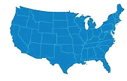
PLANS ON THE NATIONWIDE NETWORK
Benefit | TRS-ActiveCare HD (formerly 1-HD) |  | TRS-ActiveCare 2
 | In-Network | Out-of-Network | In-Network | Out-of-Network
Individual Deductible | $2,800 | $5,500 | $1,000 | $2,000
Family Deductible | $5,600 | $11,100 | $3,000 | $6,000
Individual Out-of-Pocket Max | $6,900 | $20,250 | $7,900 | $23,700
Family Out-of-Pocket Max | $13,800 | $40,500 | $15,800 | $47,400
Office Visit | 20% after ded. | 40% after ded. | $30 PCP Copay $70 SPC Copay | 40% after ded.
Urgent Care | 20% after ded. | 40% after ded. | $50 Copay | 40% after ded.
TRS Virtual Health (Medical) | $30 Cost | N/A | Covered at 100% | N/A
Preventive Care | Covered at 100% | Covered at 100% | Covered at 100% | Covered at 100%
Inpatient Admission | 20% after ded. | 40% after ded. | $150/day Copay + 20% after ded. | 40% after ded. ($500/day max.)
Emergency Room | 20% after ded. | 40% after ded. | $250 Copay + 20% after ded | $250 Copay + 20% after ded.
Free-Standing Emergency Room | $500 Copay + 20% after ded. | $500 Copay + 40% after ded. | $500 Copay + 20% after ded. | $500 Copay + 40% after ded.
95%
Notes:
Now we’re going to review the plan highlights for the two plans that are on the Nationwide Network, ActiveCare HD (formerly ActiveCare 1-HD) and ActiveCare 2:
Here on the left you’ll see that ActiveCare HD is similar to the current 1-HD plan. This high deductible plan has a lower premium and works with a health savings account so that you can pay for medical care and drugs tax-free. On this plan, the deductible must be met before the plan pays for non-preventive care.
Now lets look at ActiveCare 2 here on the right. It is closed to new enrollees, but existing participants can stay enrolled in the plan. This plan has a lower deductible and has copays for many services.
Both plans, do not require you to select a PCP and referrals are not needed for Specialty care.
As a reminder, preventive care is covered at 100% on these plans when you use in-network providers - this means no out-of-pocket costs to you.
You’ll notice again there is a figure here on the right. The nationwide network includes over 95% providers and hospitals in the United States! Talk about coverage!
FAQ:
TRS Virtual Behavioral Health
ActiveCare HD: 20% after deductible
ActiveCare 2: $70 Copay
The term a true emergency is an industry standard, not just with BCBS. However, this is commonly defined as an onset of acute symptoms including severe pain that any prudent layperson would reasonably expect the absence of immediate medical attention to result in loss of life, limb, or serious injury to bodily organs. Additionally, you will have access to a 24/7 nurseline starting 9/1 to help you access/triage the best level of care.

Slide 18
STATEWIDE Network Plan HIGHLIGHTS
TRS-ActiveCare Primary (New)
TRS-ActiveCare Primary+
1. In-Network coverage ONLY
2. PCP selection REQUIRED to have access to benefits. Otherwise claims are denied.
3. Referrals REQUIRED to see specialists
4. Access to a statewide network
Notes:
The plans on the statewide network include the ActiveCare Primary (NEW) and the ActiveCare Primary+ (formerly ActiveCare Select)
These plan offer:
1. In-Network coverage ONLY
2. Physician direct plans in which a PCP selection REQUIRED to have access to benefits. Otherwise claims deny.
3. Referral REQUIRED to see Specialists
4. Access to a statewide network
In summary, the Statewide plan network offers in-network only coverage and is a physician-directed plan, meaning you must select a PCP. Referrals are required for Specialist care, and there is access to a statewide network.

Slide 19
NATIONWIDE Network Plan HIGHLIGHTS
TRS-ActiveCare HD
TRS-ActiveCare 2
1. In-Network and out-of-network benefits available
2. PCP selection not required to access benefits
3. Referrals not required to see Specialists
4. Access to a statewide and national network
Notes:
Although both networks offer a robust access to care– there are some key differences:
The plans on the nationwide network include ActiveCare HD and ActiveCare 2 which offers:
1. In-Network AND Out-of-Network benefits available
2. Keep in mind that PCP selection NOT required to access benefits
3. Referrals NOT required to see Specialists
4. Access to a statewide AND national network
In summary, the plans on the Nationwide network offers in-network and out of network coverage and does not require a PCP selection. Referrals are not required for specialist visits and there is access to care statewide and nationwide.

Slide 20
NETWORKS OF CONFIDENCE
1. Emergency coverage anywhere in the world
2. Receive the highest level of benefits and frequently pay less for care with in-network providers.
3. Get protection from billing over the allowed amount (balance billing) with in-network providers.
4. Out-of-state coverage for dependents*
Notes:
Although you are presented with many options, you can choose with confidence knowing that both the nationwide and statewide networks provide you with:
1. Emergency coverage anywhere in the world
2. Receive the highest level of benefits and possibly pay less for care with in-network providers
3. Protection from billing over the allowed amount (balance billing) with in-network providers
4. Both the statewide and nationwide plans provide coverage for out of state coverage dependents. The nationwide plan already provides this coverage without any additional steps. However, dependents on the statewide plans will require an attestation form be submitted before they will have access to coverage outside of the state.
FAQ:
Out-of-state
The policy subscriber (employee) must complete an Out-of-State Dependent/Attestation Form which can be obtained online or from one of our dedicated BCBSTX Personal Health Guide. This form will be sent to BCBSTX to process and that will give their dependent access to benefits outside of Texas.
After completing the Out-of-State Dependent/Attestation Form, the dependent will receive an exception letter stating they can receive out-of-state coverage through the Participating Provider nationwide network. To search for a participating plan provider, the dependent will need to access the BCBSTX public site at www.bcbstx.com, choose find a doctor or hospital and choose the “ParPlan Network.”

Slide 21
Understanding your FAMILY DEDUCTIBLE
Applicable to all TRS-ActiveCare plans
All plans include an individual deductible as well as a family deductible.
This means an individual can meet their own deductible and get plan benefits even if the combined family deductible has not been met.
The individual deductible also applies towards the family deductible.
Each family member continues to meet their own deductible until the family deductible is met.
Notes:
Now let’s take a moment to better understand how your deductible will work whenever covering a family under any of the TRS ActiveCare plans.
Last Year:
The ActiveCare 1-HD plan required your family to meet the entire family deductible before benefits apply to any individual. This amount could be met by any one individual or combination of individuals on the plan.
This Year
We’re introducing an integrated individual and family deductible on all TRS-ActiveCare plans
All plans, including HD and the new Primary plan, will allow a single family member access to medical benefits once they meet their individual deductible. This can save families money in the event that one family member incurs a large number of medical expenses.
Each member of the family has their own individual deductible and all of individual deductibles feed into the family deductible.
Once an individual’s deductible is met, plan benefits begin for that individual. Once the family deductible is met, plan benefits begin for every person active on the policy, even if all individual deductibles have not been met.
Once the individual meets their individual deductible, they can no longer contribute to the family deductible. Coinsurance and copays will only count towards the maximum out-of-pocket.
FAQ:
Copays do not apply towards deductible. However, they do apply towards the out of pocket maximum.
Deductible and plan year are one in the same

Slide 22

Understanding Your Family Deductible
Amy covers a spouse and two dependents
TRS-ActiveCare Primary has a $2,500 in-network individual deductible and a $5,000 in-network family deductible.
Plan pays for certain benefits for an individual as his/her deductible is met
Everyone helps to meet the family deductible, but no one person pays more than the individual amount
Since Amy has met her deductible, she will only pay a 30% coinsurance for certain medical services
Amy
Ted
Bob
Sue
$2,500
$800
$600
$0
Notes:
Example: Here is an example to clarify this plan feature. Amy is on a family plan with her spouse and two children. Amy has met her $2,500 individual deductible, so she now only pays 30% coinsurance for certain medical services. The coinsurance and copays Amy pays will not go towards her family deductible. Those payments will only go toward the individual and family maximum out-of-pocket.
The remaining family members (excluding Amy) will continue to work towards their own deductible limit until the family combined has met the $5,000 deductible or they meet their own individual deductible, whichever happens first.

Slide 23
In-NETWORK VALUE
In-Network Providers
Receive the highest level of benefits and frequently pay less for care No claim forms (providers submit claims) Protection from billing over the allowed amount (balance billing)
Out-of-Network Providers
Receive fewer out-of-network benefits and pay more for care. You may need to file your own claims. Risk being billed over the allowed amount (balance billing).
*Out-of-network benefits only apply to TRS-ActiveCare HD and TRS-ActiveCare 2.
Notes:
Next I want to share with you the power that staying in-network offers you and your family.
Advantages on staying In-Network include:
Receiving the highest level of benefits – which means keeping more money in your pocket
You don’t have to file any claims forms – providers do that for you
Balance billing is not allowed! Your are protected from balance billing and you can have added peace of mind.
Although the ActiveCare HD and ActiveCare 2 plans offer out-of-network coverage, you get the most from the benefits when you stay in-network.
When you go out-of-network be aware:
Benefits pay at a lower level – meaning you pay more out of pocket for care
You will probably have to file your own claims
Providers have the ability to balance bill you
I want to remind you that ActiveCare Primary and ActiveCare Primary+ plans DO NOT provide any out-of-network benefits unless in true emergencies. All non-emergency claims for out-of-network services will be denied.

Slide 24

Why Should I Select a PCP?
Your Primary Care Provider:
Your PCP will get to know your overall health history and can guide you toward preventive care to help you be healthy and active.
You can build a trusting, long-term relationship, which may make it easier to talk about personal health matters.
Your PCP will help take care of you when you’re sick and help you stay healthy with preventive care.
Will manage your referrals to
specialists if you’re on the physician-directed plans (TRS-ActiveCare Primary+,TRS-ActiveCare Primary).
Notes:
If you are newly eligible, or if you already have a plan but haven’t selected a (PCP), you may be wondering why it’s worthwhile to do so.
Having a PCP is important, even if you rarely go to the doctor or get sick.
For starters, your PCP is the single best resource for knowing and understanding your health. This includes knowledge of your personal health, your family history and risk factors, the medications you are taking, and your overall lifestyle. He or she can make sure you’re getting the care you need and are up-to-date on any age/gender preventive screenings or immunizations that may be needed.
Your PCP also can easily treat many non-urgent health issues like colds and flus, rashes, allergies and respiratory infections in the event you get sick. Also, the cost of seeing an in-network PCP under your plan is significantly less than going to an urgent care facility or an emergency room. Seeing a PCP for health issues is one of your lowest cost options of care!
******Lastly, if you’re on the statewide network your PCP is responsible for managing any referrals to specialists that may be needed (referrals are only required for ActiveCare Primary and ActiveCare Primary+ participants). If you need to see a specialist for help with a current health condition or issue, your PCP will assist you in providing a referral to that provider.
FAQ:
PCP Provider Types: Geriatric, Family, or General practitioner; Pediatricians, OB/GYNs, and Internists.
Your are not required to have a referral to see your OBGYN.

Slide 25

Preventive CARE Coverage
What’s Covered?
  Recommended routine gender and
  age-specific preventive care and screenings –
  including yearly general wellness exams, recommended vaccines and screenings for conditions like diabetes, cancer and depression – both facility and professional services
  In-network care covered at 100% with no copay,
  no deductible. Out-of-network benefits may vary.
  Note: TRS-ActiveCare Primary and TRS-ActiveCare Primary+ plans require preventive services to be rendered by your selected in-network PCP to receive 100% coverage with no copay.
IMPORTANT to remember:
Lab tests related to a condition
such as diabetes or asthma –
are not considered preventive
and are covered under applicable
deductible and coinsurance levels.
Stay Healthy by Getting Regular Check-Ups
Notes:
We want to take the opportunity to stress the importance of getting regular annual check-ups. As a reminder, preventive care is covered at 100% with no out-of-pocket costs owed when you use in-network providers regardless of the plan you select.
***Note: With TRS-ActiveCare Primary and Primary+ plans preventive services MUST be rendered by your in-network PCP to receive the 100% coverage with no additional out of pocket costs.
IMPORTANT to remember: Lab tests related to an illness or condition – such as diabetes or asthma – are not considered preventive and are covered under applicable deductible and coinsurance levels. Because these tests feel “routine” to the participant, this can cause confusion.

Slide 26

24/7 Nurseline
Staffed by registered nurses, the 24/7 Nurseline provides answers to general health questions and guides you to your primary care provider, urgent care center, the ER, Virtual Health provider or other care, as necessary.
These nurses can help you choose the right level of care and address health concerns about:
Asthma
Back Pain
Cuts or Burns
Diabetes
Fever
And much more
To reach the Nurseline, call the dedicated team of Personal Health Guides available at:
1-866-355-5999
Over 300 Audio Health Library topics ranging from allergies to surgeries available in English and Spanish!
Notes:
The TRS-ActiveCare plans have a Nurseline staffed by registered nurses 24/7 to conveniently assist you with your health questions.
Nurses can answer general health questions and guide you to the appropriate level of care – whether it’s a visit to you PCP, Virtual Health provider, Urgent Care, or the Emergency Room.
Additionally, you can access an Audio Health Library that has information on over 300 topics – available in English and Spanish.
They can be reached at 1-866-355-5999 which will be located on the back of participant ID cards.

Slide 27
Carrier Transition
Highlighting Tools/Resources
Notes:
We understand that there are a lot of changes this year and want to ensure you are armed with the right tools and resources to make the best plan selection for you and your family.

Slide 28

TRANSITION OF CARE
Transition of Care
Applies to you or your covered dependents who are receiving care on or after Sept. 1, 2020, from a provider who is not part of BCBSTX’s networks
If approved, benefits will be paid at the in-network level for a specified period of time. Examples of who may be eligible for transitional care include those:
    Receiving cancer treatment/therapies
    Being treated for a terminal illness
    In your second/third trimester of pregnancy
    In cardiac rehabilitation
Submit the Transition of Care form prior to September 1. You will receive a decision by mail.
Completion of this form is not a guarantee of coverage.
Notes:
TRS understands that your health is of highest priority and should not be put on hold during this transition
Therefore, you have an option to submit a Transition of Care form for yourself or your covered dependent that is receiving care from a physician and is not in-network with BCBS.
If approved, benefits will be paid at the In-Network level for a certain period of time. Examples of those who may be eligible for Transition of Care benefits include those:
In cancer treatment
Being treated for a terminal illness
In your second/third trimester of pregnancy
In cardiac rehabilitation
Keep in mind this is not a comprehensive list. If you are undergoing a unique/complex treatment we encourage you to submit for review.
The Transition of Care form can be easily accessed on the participant website.
FAQ:
Includes those in second trimester as well.

Slide 29
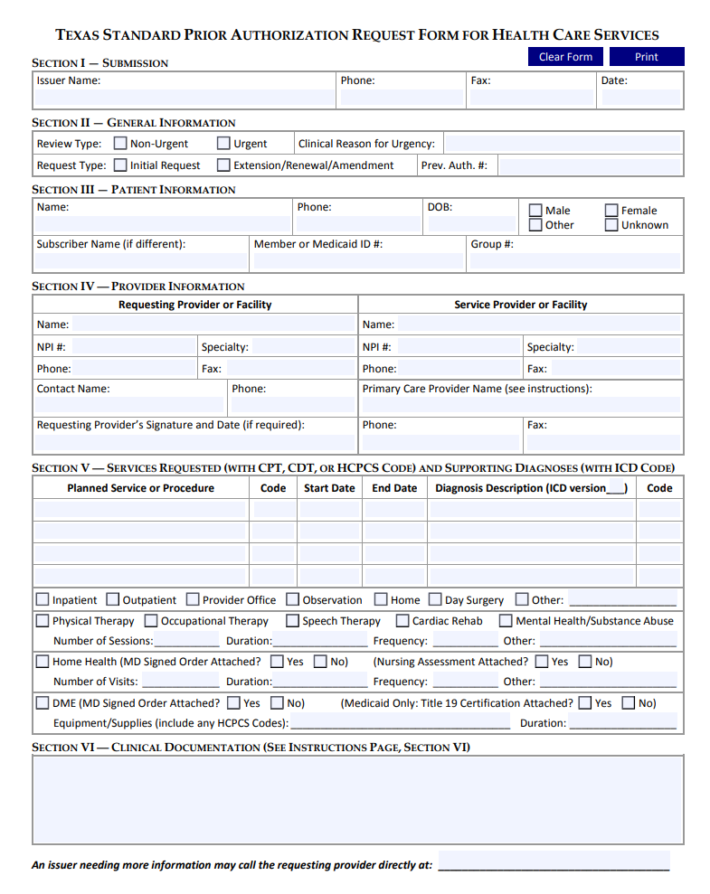
Prior Authorizations
BCBSTX Provider
Valid through end date
Sept. 1, 2020
If issued through Aug. 31, 2020, Aetna will transfer to BCBSTX
If not a BCBSTX Provider
Valid for 90 days or the end date (whichever is sooner)
Note: Please work with your selected PCP to re-establish any existing referrals as referrals will not be transferred from your current carrier. Once re-established they can be valid for up to a year!
If issued on or after Sept. 1, 2020
BCBSTX Provider
Valid through end date
If not a BCBSTX Provider
Not valid
Notes:
A common question that is asked by during a carrier transition is ‘What happens to any Prior Authorizations I currently have on approved?
If you have an approved prior authorization from Aetna prior to September 1st, Aetna will send that information to Blue Cross Blue Shield and we will honor it.
If the prior authorization is for services rendered by a physician in the Blue Cross networks, we will honor it through the approved end date.
If the prior authorization is for services being rendered by a physician not in the Blue Cross networks, we will honor it through the approved end date – or for 90 days – whichever is sooner.
All prior authorizations starting 9/1/2020 will need to be issued by a BCBSTX provider.
Please note, that referrals will not be transferred from your existing carrier and must be re-established with BCBSTX. However, once re-established referrals are valid up to a year before needing a new referral.
Ex: If you are currently being seen by a specialist such as a cardiologist, plan to select one of the statewide plans, and coming from a plan that did not require a PCP selection….as of 9/1/2020 you will need to coordinate through your selected PCP to issue a new referral to your existing specialist/cardiologist.
FAQ:
These are the services where a referral will not be required: (Don’t have to read all if asked)
Services rendered by a backup PCP
Emergency services
OBGYN
Student Health Centers
Services where Medicare or another insurance retains primary liability
Durable Medical Equipment
Teladoc
RediMD
Urgent Care
Labs
Routine Eye Exams
Mental Health Visits
Minute Clinics
If the PCP submitted all the necessary information for a review. It can take anywhere from one to three business days. Usually its faster when the provider submits this referral electronically.

Slide 30
IMPORTANCE OF PCP SELECTION
During Annual Enrollment it is very important that you select the PCP you want to direct your care if you enroll in a plan that requires PCP selection (TRS-ActiveCare Primary and TRS-ActiveCare Primary+).
EVERY family member covered on one of these plans must select their own PCP.
If you don’t use your PCP for routine medical care, obtain referrals from your PCP to see specialists, or use in-network providers, you won’t have coverage. Claims will be denied and you will be responsible for payment to the provider.
Notes:
In the spirit of activating your health, we want you to understand that taking action will help you maximize your benefits.
We always encourage you to have a PCP regardless of the plan you choose, but for those selecting the statewide physician-directed plans (ActiveCare Primary or the ActiveCare Primary+ plan) you MUST select your PCP during annual enrollment.
A couple other items be aware of:
Each family member must have their own PCP selected. For example, Mom and 2 kids are covered on the plan. Mom must choose her PCP during annual enrollment, and she must also select a PCP for her 2 kids. It can be the same PCP or different PCP’s – but each family member must have a PCP tied to him/her.
* If you don’t use their PCP for routine medical care, get referrals from your PCP before you see specialists, or use in-network providers, you won’t have coverage. Claims will deny and you will be responsible for payment to the provider.

Slide 31
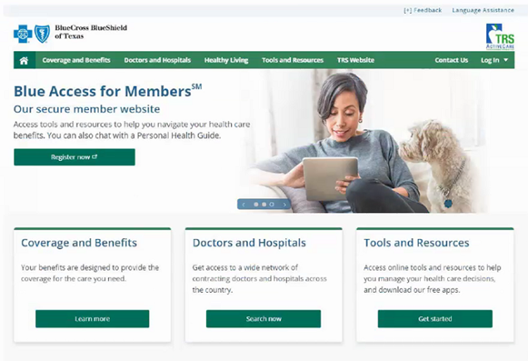

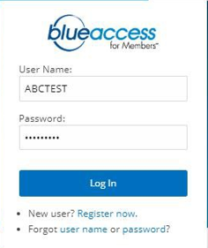
Participant Website
Website for TRS-ActiveCare Participants
Available June 1, 2020
Find an in-network doctor, hospital, or other provider
Get plan information
Get the latest news and updates
Download forms and documents
Learn about health and wellness resources
Available Sept. 1, 2020
Register for Blue Access for Members
Select or change your PCP
Check the costs of doctors and services covered under your plan
Download a temporary ID Card
www.bcbstx.com/trsactivecare
Notes:
The TRS-ActiveCare website will be you first stop shot for medical benefits and any health and wellness information. It is dedicated to ActiveCare plans and has coverage specific information that will be helpful to you throughout the year.
The participant website is available now and feature options to:
Find an in-network doctor, hospital, or other provider
Get plan information
Get the latest news and updates
Download forms and documents
Learn about health and wellness resources
You can access the Provider Finder Search tool from the ActiveCare site without signing into the member portal. Simply click on the Doctors and Hospitals tab shown here by the red circle on the left, then chose the plan you want to search providers for.
The participant website will then be expanded as of 9/1/2020 and offer ways to:
Register for Blue Access for Members
Check the costs of doctors and services covered under your plan
Download a temporary ID Card
You can access the Blue Access for Members participant portal by going to (www.bcbstx.com/trsactivecare) and clicking on “Log In” at the top right-hand corner of the home page shown here with the red circle on the right. This portal allows you to find information related to your medical coverage, finding a doctor, claims, referrals and prior authorizations, download temporary ID cards, and links to various health and wellness programs available. When you first sign up, you will need to have your member ID number to create your personalized account. If you don’t have your ID number you can contact one of our personal health guides (more to come later) or the benefits administrator at your district.
Blue Access for Member is available in Spanish and English

Slide 32
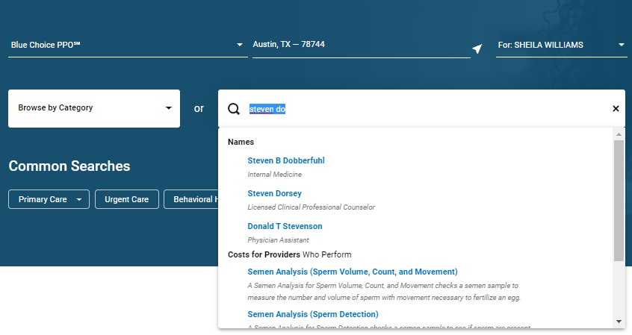
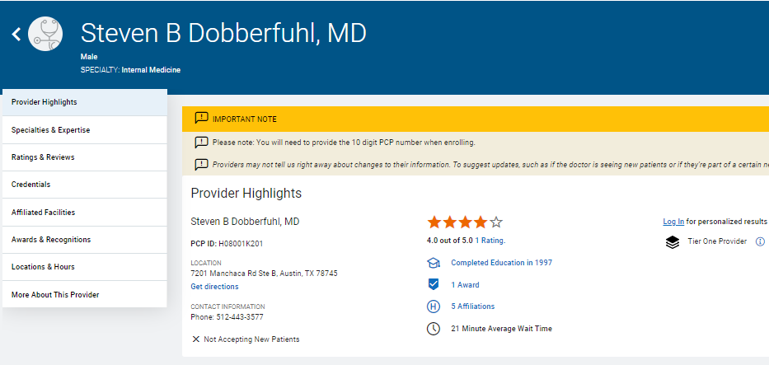
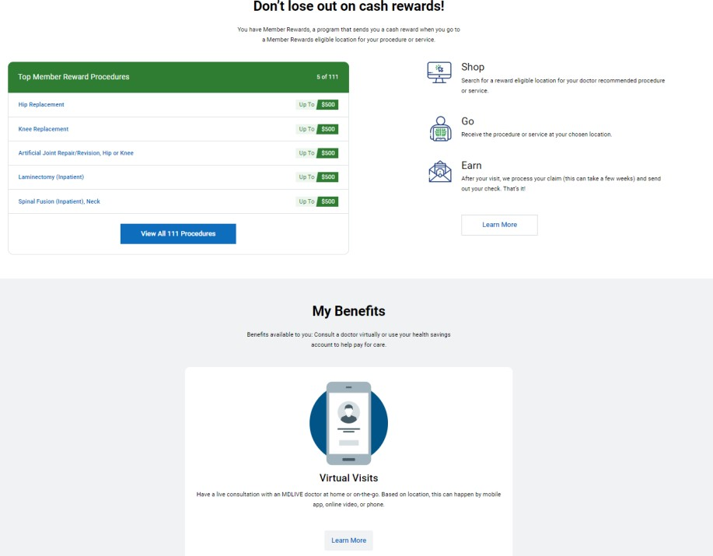
Provider Finder®
Search Bar
Detailed Provider Profile Page
Notes:
As mentioned on that previous slide, you can access the Provider Finder Search tool from the ActiveCare site by clicking on the Doctors and Hospitals tabs then choosing the plan you want to search providers for.
On the left here we see a screen shot of our Provider Finder within ActiveCare Member Site. This is a tool we encourage you to use when selecting a Primary Care Provider.
When you search for a provider, you get more than just a list of doctors. You get:
Quality designations for facilities and physicians, including Awards & Recognitions
Enhanced demographic information on each provider – find out about a doctor’s education, hospital affiliations and whether they are board-certified
Customizable search options – prefer a doctor who is a woman or can speak Spanish? You can search for one.
Patient reviews – find out what others have to say about a physician
Alternate location – does the doctor practice at multiple locations? Find the one most convenient for you.
After completing a search and clicking on the provider’s name it will take you to the detailed provider page which is shown here on the right. Notice the red circle, this is where you can locate the provider’s PCP ID which will be needed to assign a provider as your PCP prior to 9/1/2020.
Remember: If you are uncertain how to navigate to the details provider page and locate the PCP ID we have our personal health guides currently available to assist you.
Additionally, this tool is available in Spanish and English
Our provider finder has additional features where you can get an estimate of costs for hundreds of different procedures. When you’re signed into Blue Access for Members, the tool uses your specific benefit information to provide an estimate based on BCBSTX contracted amount with different providers and your remaining responsibility for the year, such as whether you have met your deductible or whether you have reached your out-of-pocket maximum.

Slide 33
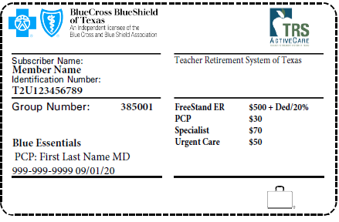
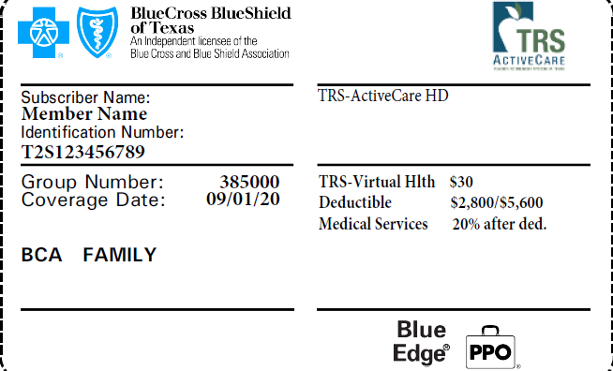
Your BCBSTX ID Cards
You will receive new ID cards.
For physician-directed plans, each family member will get their own ID card with their PCP’s name printed on it.
You can call a Personal Health Guide or log on to Blue Access for MembersSM to order additional or replacement ID cards.
www.bcbstx.com/trsactivecare
Notes:
With the transition to BCBSTX you will receive new ID cards.
Remember how we showed you where to locate the PCP ID needed to select your PCP prior to 9/1/2020? That selection will then be shown on the card here on the left for those on the statewide plans.
ID cards for the physician-directed statewide plans will have the subscriber’s name listed as well as one covered family member and their associated PCP. This means, if you choose one of the statewide plans everyone in your family on will have their own ID card. A sample of the ID cards for this is shown here on the left with the blue circle on the PCP indicator.
ID cards for the nationwide plans, shown here in the middle, will only have the subscriber’s name on the card and will never have the spouse and/or dependents name. Additionally, if you choose one of the nationwide plan will receive up to 2 ID cards per family. (Additional available upon request.)
You can order additional or replacement ID cards via Blue Access for Members (the participant portal), directly through the BCBSTX App, or with a dedicated personal health guide. Additionally, your district Benefits Administrators can order a permanent or temporary card on your behalf.
FAQ:
Multiple ID cards may be received based on when enrollment is received. Each mailing will include messaging instructing what to do and call PHG if any questions or concerns.
For the nationwide plans
We provide 1 card for the subscriber and 1 additional card if there are 2 or more people on the plan.
Ex: This could be a subscriber a spouse and 2 kids or just a subscriber and spouse, either way, you only get 2 cards. Additional cards can be ordered for dependents living out of the parents home or old enough to have their own card and we will mail it to them.
Only the subscriber's name ever appears on the card. The PPO card will never have the spouse and/or dependents name.
For Statewide plans
For physician-directed plans, each family member will get their own ID card with their PCP’s name printed on it.

Slide 34
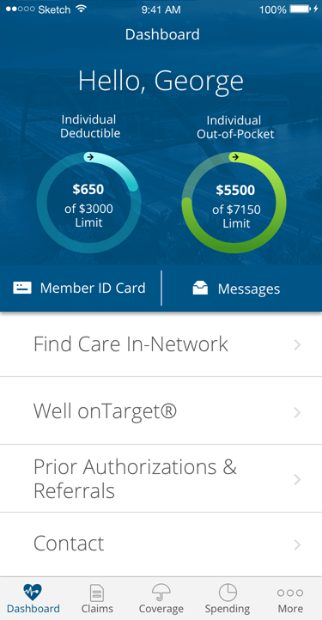
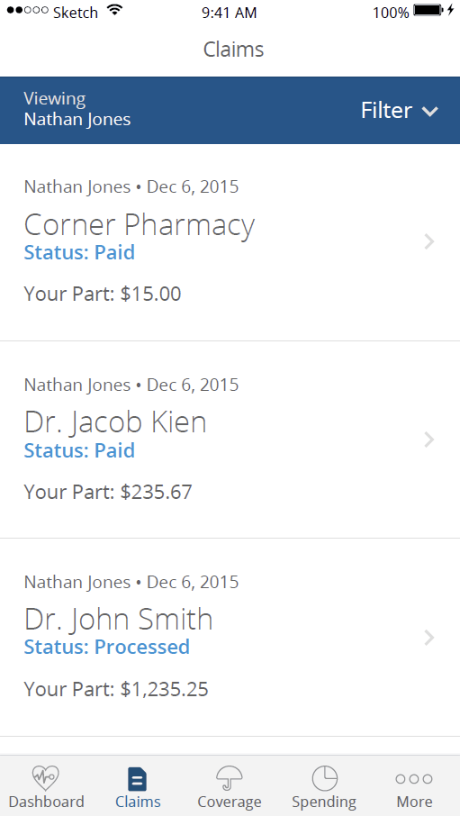
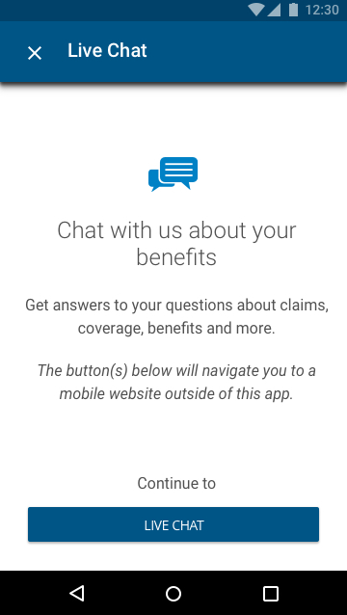


Mobile Access
BCBSTX App – Available Sept. 1, 2020
Dashboard
See claims and EOBs
Live chat
Monday-Friday 7:00AM-6:00PM
Notes:
The BCBS of Texas App allows you to find the most important information quickly and easily. You can use the app to check claims status, track deductibles and out-of-pocket maximums, view prior authorizations and referrals, and out-of-pocket spending. If you have an iPhone, you can view your ID card and add it to Apple Wallet. You can even email your ID card to providers.
The BCBSTX app also is available in Spanish for both iPhone and Android users.
TRS Health App will be sunset and the BCBSTX app will be available starting 9/1/2020.
With Blue Access for Members and the BCBSTX App, your benefits are at your fingertips, wherever you are. Our online tools help you stay informed and better manage your health, wellness, and benefits.

Slide 35




TRS Virtual Health
Your BCBSTX coverage includes TRS Virtual Health choices powered by Teladoc® and RediMD.
Medical
Cold and flu symptoms
Allergies
Bronchitis
Respiratory infections
Stomach upset
Sinus problems
Skin problems
Mental Health
Depressive and anxiety disorders
Bipolar, schizophrenia and psychotic disorders
Attention disorders
Alcoholism and addiction and substance-related disorders
Medical
Back Strains
Ankle Injuries
Shoulder Strains
Pulled Muscles
Contusions/Bruises
Asthma
Shortness of Breath
Infections
Allergies
Chemical Exposure
Available Sept. 1, 2020
Notes:
Your coverage includes TRS Virtual Health choices powered by Teladoc® and RediMD. These services allow you access to convenient, quality health care from home or on the go, without having to travel to a doctor’s office.
To the left here you recognize your existing virtual health option through Teladoc. The offer services for general medicine, including a variety of acute, non-urgent conditions. Confidential mental health services for adults 18 and older from a licensed therapist, psychologist, psychiatrist or certified drug and alcohol abuse counselor are also available. You can even have prescription medication sent right to your home, when medically necessary.
Now lets shift our focus to the right side of the screen. Starting 9/1/2020 you will have as to RediMD! They provide quality primary care medical service with live, face-to-face diagnosis and treatment via the internet by computer or smartphone as well as services over the telephone. You can see and speak with a board-certified physician 24/7 who can diagnose and recommend conservative treatment.
FAQ:
TRS Virtual Medical
ActiveCare HD: $30 copay
ActiveCare 2/Primary/Primary+: Covered at 100%
TRS Mental Health:
ActiveCare HD: $185 for initial with psychiatrist, $95 for on-going appointments with psychiatrist and $85 for therapy appointments
ActiveCare 2/Primary/Primary+: $70 Copay

Slide 36
Additional Programs
Highlighting Wellness and Family Planning
Notes:
We want to let you know that the TRS-ActiveCare plans offer a wealth of additional programs and services including wellness and family planning resources.

Slide 37


Well onTarget®
Participant PORTAL
RELEVANT.
TIMELY.
IMPACTFUL.
PERSONALIZED.
Health Assessment
Digital self-management programs
Trackers and tools
Blue PointsSM Rewards
Fitness Program
Tracking for fitness and nutrition
and also device integration
Personal wellness challenges
Notes:
The Well onTarget portal is where you will start engaging in wellness activities that are personalized for you.
There are many activities on Well onTarget to encourage and help you along your wellness journey.
Activities include Taking a Health Assessment, various trackers, syncing a fitness or nutrition device or app, self-management Programs on key health topics and even access to a personal health coach.
You can also earn Blue Points Rewards by participating in eligible wellness activities on the portal which we will discuss next!
FAQ:
Naturally Slim and Real Appeal are not currently an offering with ActiveCare plans.
Participant Dashboard
The innovative design of this page makes it simple for you to access your goal information, self-management program information, status of program steps, food and exercise diary, and RSS feeds of current health news which is pertinent to your active goals.
Health Assessment
Our health assessment is available through our participant dashboard page. Your Personal Wellness Report that is generated from the health assessment can be accessed at any time through the portal.
Self-Management Programs
Programs are intended to provide key clinical and behavioral information that is pertinent to your wellness opportunities, the tools to understand why you are motivated to change and tips on sustaining a high level of motivation, and – most critical to the behavior change process – the appropriate tools and resources that teach you how to change and how to maintain those healthy behaviors over time. There are over 20 topics available.
Trackers and Tools
Goal Trackers give you a way to track and supply information related to the goals you have chosen.
Text Message Alerts
You can set up mobile reminders such as to track your blood pressure or get 8 hours of sleep a night.
Blue Points You will earn points for completing Blue Points-eligible activities and can redeem them for merchandise as well as supplement point balances with a personal credit card.
Blue Points Program Rules are subject to change without prior notice. See the Program Rules on the Well onTarget Participant Wellness Portal at wellontarget.com for further information. Your company may have additional reward programs in place to encourage you to take advantage of certain preventive care and wellness activities or for making healthy changes. Check your employee benefits.
To access the portal download the AlwaysOn app or visit wellontarget.com and log in using your Blue Access for Members user name and password.

Slide 38

Blue Points
BUILT-IN
REWARDS
Offerings that earn points:
Use of online trackers
Connecting and syncing a
fitness device or app
Health assessment completion
Digital self-management
program completion
Fitness program visits
Redeem points in the online Shopping Mall with over a million products!
Notes:
You can earn Blue Points Rewards by participating in eligible wellness activities on the portal and redeem them at our Online Shopping Mall, with over a million products to choose from.
In the Well onTarget portal you will be able to see all the activities listed and their corresponding point value.
The points add up quickly, never expire, they roll over from year to year!

Slide 39
FITNESS PROGRAM
Base | Core | Power | Elite
$19 per month | $29 per month | $39 per month | $99 per month
$19 Initiation Fee
Tiered Gym Network
A choice of gym networks to fit your budget
and preferences
Studio Class Network
Includes boutique-style classes and specialty gyms with pay-as-you-go option and 30% off every 10th class
Family Friendly
Gym network provides access to dependents at bundled price discount
Mobile App
Allows members to access location search, studio class registration, location check-in and activity history
Provides you a flexible option
to live a healthy lifestyle with multiple gym packages and pay-as-you-go studio classes
Additional Perks
No long-term contract
Additional access to other discounts, such as complementary and
alternative medicine
    Blue Points for joining and using regularly
    Real-time data provided to the mobile app and Well onTarget® portals, feeding Blue PointsSM
Blue Points Program Rules are subject to change without prior notice.
See the Program Rules on the Well onTarget Member Wellness Portal at wellontarget.com for further information.
Notes:
Your plans also provide a discount to various gyms and fitness centers.
You can access the Fitness Program Network to locate fitness centers under Quick Links on the Blue Access for Members homepage
The Network is nationwide with over 10K participating facilities.
You pay a one-time initiation fee of $19+tax along with a monthly fee based on your tier selection.
Blue Points can be earned for joining the fitness program (2,500) and based on frequency of gym check-ins.
If you already have a gym that is participating with our fitness program you have to cancel your gym membership before joining our program to avoid duplicated billing.
FAQ:
Family Bundle: Members will be able to save an additional 12% by adding family members and dependents to current account.
Some gyms may have a fob to access their facility and is not covered by this fitness program. Therefore, you may be responsible for paying the one time cost for the fob directly with the gym.
To register, search for a location or learn more about the Fitness Program, log in to your Blue Access for Members account and click the Fitness Program link found in the left-hand menu bar. You can also call us toll-free at (888) 762-2583, Monday through Friday, between 7 a.m. and 7 p.m., CT (6 a.m. and 6 p.m., MT).
An additional bonus for being a member of the fitness program: you receive up to 30% off various alternative medicine services from health and well-being professionals. These include: acupuncture, massage, dieticians, childbirth educators, personal trainers and physical therapists. To take advantage of these discounts, register at whlchoices.com.
Please note: Discount programs are not part of your TRS plan, but are offered as a “value added” benefit by BCBSTX.
Search Locations:
Website:
bcbsilforyourhealth.com; Enter address, city or ZIP code
Comments
Price:
Initiation Fee: Initiation fee will be the same across all four tiers: $19.00
Monthly Fee: Members will have the option to select between four tiers based on low, medium, and premium gyms.
Facilities:
Gym Facilities Network Size: Members will have access to gyms in current tier and subsequent tiers. Elite members will have access to one Elite facility and subsequent tiers.
Gym Facilities within Network: Members will be able to search gyms by tier on the Fitness Program website and the app.
Studio Class: Studio classes are available to members even if they do not have a gym tier membership. The studio classes are purchased as a pay-as-you-go option with a 30% discount on every 10th class.
Experience:
Mobile App: The mobile app will allow members to sign up for studio classes, check-in, and look up history.
Gym/Studio Check-in: Gym and studio class check-in can be conducted by the mobile app.

Slide 40


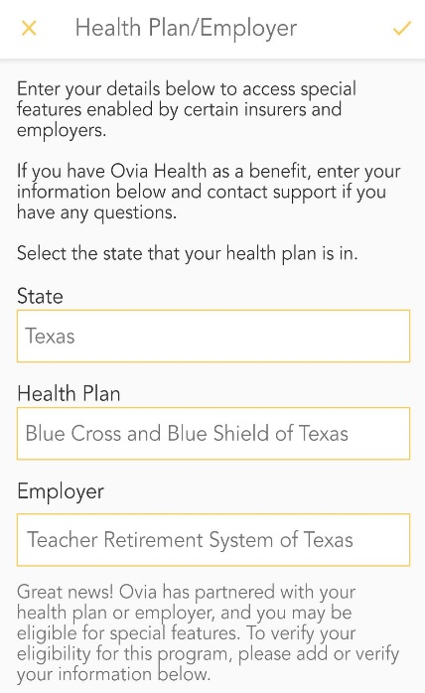
Women’s and Family Health
An Innovative Approach for the Journey into Parenthood
Our programs feature education, coaching, maternity management solutions, and can result in improved clinical outcomes and cost savings.
Ovia Health Apps: Videos, tips, coaching and more
  Ovia Fertility: Helps you track your cycle and predict when you are more likely to get pregnant
  Ovia Pregnancy: Helps monitor pregnancy and baby’s growth week by week leading up to the baby’s due date
  Ovia Parenting: Allows you to keep up with your child’s growth and milestones from birth through three years old
High-risk Maternity Management: Maternity specialists
conduct phone outreach and provide ongoing support to expectant mothers identified with high-risk pregnancies
Well onTarget Programming: Interactive online courses designed to optimize the health of women and their babies
New Users are prompted to enter their employer as: Teacher Retirement System of Texas
Notes:
TRS recognizes and understand the needs of their population being predominantly female. Therefore, there are tools to help those who are pregnant or planning to get pregnant – at no extra cost.
Ovia Health apps are for tracking your cycle, pregnancy and baby’s growth. Each app has videos, tips, coaching and more.
Ovia Fertility helps you track your cycle and predict when you are more likely to get pregnant.
Ovia Pregnancy helps you track your pregnancy and baby’s growth week by week leading up to your baby’s due date.
Ovia Parenting helps track your child’s growth from birth through three years old.
Well onTarget® has self-guided courses about pregnancy that you can take online, covering healthy foods, body changes, labor and more.
Plus, if you are experiencing a high-risk pregnancy, BCBSTX will provide support from maternity specialists to help care for you and baby.
On 9/1/2020 you can download any of the Ovia Health mobile apps in the Apple or Google store. You’ll need to have member ID number handy so you can enter your BCBSTX ID number when you set up your account. Also, visit www.wellontarget.com to explore our online courses.
First Time Users: when prompted, enter Teacher Retirement System of Texas.

Slide 41
YOUR DEDICATED SUPPORT
Who to Contact
Notes:
TRS understands that your schedules can vary day to day or even week to week and has ensured that we have a dedicated team to help you no matter what time of day is most convenient for you. Let’s take a look.

Slide 42

Support for you
Personal Health Guides (PHGs)
Answer questions about benefits
  Assist with prior authorizations and referrals
  Find and assign an in-network PCP
  Address claim and billing inquiries
Explain health care costs and options for care
  Locate in-network provider options
  Scheduling appointments
Help you use self-service tools
Connect you to other resources
  Clinicians
  Community resources
  TRS benefits vendors
Call toll-free: 1-866-355-5999
June 1, 2020
Monday-Friday 7:00AM-6:00PM
Sept. 1, 2020
Access 24/7
Notes:
One of the most useful resources available to you are the Blue Cross and Blue Shield of Texas (BCBSTX) Personal Health Guides
BCBSTX Personal Health Guides are here to help you and your covered family members with:
Finding and assigning your PCP
Answering questions you have on your benefits and coverage
Checking the status of prior authorizations and referrals
Helping you understand your health care costs and options for care
Scheduling appointments for doctor’s visits,
Help with navigating participant website and mobile tools
Along with connecting you with a nurse to help you learn more about a diagnosis or medical condition and identify resources available to you in your community.
Remember, there is one toll-free number to call: (866) 355-5999. A BCBSTX Personal Health Guide is available to assist you 24/7 beginning on 9/1/2020. They are currently available M-F 7AM-6PM.
Let me take a moment to say, we are proud to partner with TRS to elevate your benefits experience!
A: That’s all I have for today, please don’t hesitate let me know if you have any questions
B: Thank you so much for your time. Now, I’ll pass it back to ______. Ill be available at the end for medical benefit related questions.

Slide 43
Pharmacy Benefits
Notes:
Next we’ll review the ActiveCare pharmacy benefits. CVS Caremark will continue to manage the pharmacy benefits for TRS-ActiveCare. You can continue to fill your prescriptions at your current pharmacy.

Slide 44
TRS Prescription Drug Plan Deductibles/Maximum Out-of-Pockets
Benefit | TRS-ActiveCare Primary | TRS- ActiveCare HD | TRS-ActiveCare Primary+ | TRS-ActiveCare 2
Drug Deductible
(per person, per plan year)
$2,500 individual, $5,000 family
$2,800 individual, $5,600 family
$0 generic; $200 brand only Rx
$0 generic; $200 brand only Rx
  Maximum Out-of-Pocket
$8,150 individual, $16,300 family
$6,900 individual, $13,800 family
$6,900 individual, $13,800 family
$7,900 individual, $15,800 family
Notes:
-The pharmacy deductibles for the HD and Primary plans are integrated with medical. Once the deductible has been met, you will be responsible for a percentage of the drug cost (coinsurance). Since the deductibles for HD and Primary are now embedded,, each plan participant can reach the individual deductible, or together they can meet the entire family deductible; whichever happens first.
-The changes for the 2020/2021 plan year is highlighted in red. Note- there are no changes to ActiveCare 2.

Slide 45
TRS-ActiveCare Primary & HD Plans: No Cost Generic Preventive Medications
Certain generic medications classified as “preventive,” such as a prescription medication used for hypertension or depression, may be available at no cost to TRS-ActiveCare Primary & TRS-ActiveCare HD participants.
TRS waives the Primary & HD plan deductible for generic preventive medications on the Generic Preventative Drug list.
Find the Generic Preventive Drug list by visiting: www.info.caremark.com/trsactivecare
Or
Call CVS Caremark at 1-866-355-5999
75.4% last year
$11.85 million annually
Percentage of participants who utilized the Generic Preventive Medication List
Amount those who utilized the Generic Preventive Medication List saved
Notes:
Many of you may be trying to prevent chronic conditions, so the plan covers certain drugs at no cost to you. These drugs prevent chronic conditions such as hypertension or depression. You can call CVS Customer Care or visit info.Caremark.com/trsactivecare for the list of medications. If your drug isn't on the generic preventive list, it may still be covered on the main formulary, in which case you'd pay the full cost until you meet the deductible, then you pay the co-insurance.
Last year, 75.4% of TRS-ActiveCare participants on the HD plan have utilized the Generic Preventive Medication List.
ActiveCare participants who have utilized the generic preventive medications saved approximately $11.85 million annually.
The Generic Preventive Drug List will remain on the HD plan and will be on the new Primary Plan.
You should always check for the updated list online as it “could” change monthly. New medications are added as they come to market and medications are removed when they are discontinued. Both the Generic Preventive List, and the Formulary List are located online at info.Caremark.com/trsactivecare.

Slide 46
Overview of TRS-ActiveCare Prescription Drug Benefits
Benefit | TRS-ActiveCare Primary | TRS-ActiveCare HD | TRS-ActiveCare Primary+ | TRS-ActiveCare 2
Drug Deductible (per person, per plan year) Maximum Out of Pocket
Short-Term Supply at a Retail Location (up to a 31-day supply limit)
Extended-Day Supply at Mail Order or Retail-Plus Pharmacy Location (60- to 90-day supply)
Specialty Medications 31-Day Supply Limit
$2,500 individual, $5,000 family
Medical + Pharmacy Combined
$8,150 individual, $16,300 family
$2,800 individual, $5,600 family
Medical + Pharmacy Combined
$6,900 individual, $13,800 family
$0 generic; $200 brand only Rx
Medical + Pharmacy Combined
$6,900 individual, $13,800 family
$0 generic; $200 brand only Rx
Medical + Pharmacy Combined
$7,900 individual, $15,800 family
$15 copay
30% coinsurance
50% coinsurance
20% coinsurance
25% coinsurance
50% coinsurance
$20 copay
25% coinsurance (Min $40/ Max $80)
50% coinsurance (Min $100/ Max $200)
  Tier 1 - Generic
  Tier 2 – Preferred Brand
  Tier 3 - Non-Preferred Brand
$15 copay
25% coinsurance
50% coinsurance
  Tier 1 – Generic
  Tier 2 - Preferred Brand
  Tier 3 - Non-Preferred Brand
$45 copay
30% coinsurance
50% coinsurance
20% coinsurance
25% coinsurance
50% coinsurance
$45 copay
25% coinsurance
50% coinsurance
$45 copay
25% coinsurance (Min $105/ Max $210)
50% coinsurance (Min $215/ Max $430)
30% coinsurance
20% coinsurance
20% coinsurance
20% coinsurance (Min $200/ Max $900)
Notes:
As you can see, the copays/coinsurance is set up based on a tier system. Usually, the more expensive medications fall under the non-preferred brand tier, thus the higher copay/coinsurance. Generics are typically the least expensive, so the copays are least expensive for the participants. The participants usually save the most money by switching to a 90 day supply, and sticking with generic medications whenever possible.
Note the plan changes: are highlighted in red
-HD plan DED and MOOP increase
-New Primary Plan
-Primary+ MOOP decrease
-removed min and max copays on Primary+ plan

Slide 47
Short-Term Supplies of Maintenance Medications
What are Maintenance Medications?
Maintenance medications are medications commonly used to treat conditions that are considered chronic or long-term. These conditions usually require regular, daily use of medicines.
Short-Term Supply of a Maintenance Medication at Retail Location (up to a 31-day supply)
The second time you fill a short-term supply of a maintenance medication at a retail pharmacy, you will be charged the coinsurance and copays below.
Benefit | TRS-ActiveCare Primary | TRS-ActiveCare HD | TRS-ActiveCare Primary+ | TRS-ActiveCare 2
  Tier 1 – Generic
  Tier 2 - Preferred Brand
  Tier 3 - Non-Preferred Brand
$30 copay
30% coinsurance
50% coinsurance
20% coinsurance
25% coinsurance
50% coinsurance
$30 copay
25% coinsurance
50% coinsurance
$35 copay
25% coinsurance (Min $60/ Max $120)
50% coinsurance (Min $105, Max $210)
Notes:
Maintenance drugs are prescriptions commonly used to treat conditions that are considered chronic or long-term. Some examples are drugs used to treat high blood pressure, heart disease, and asthma.
On the second fill of a 1-31 day supply of a maintenance medication at a retail pharmacy, the participant will be charged a convenience fee. This does not apply to the HD plan
To avoid paying the convenience fee, the participant can fill a 60-90 day supply of their maintenance medication through Caremark Mail Order pharmacy or a Retail-Plus pharmacy.

Slide 48
Where to fill Extended-Day Supply Prescriptions?
  You can fill a 90-day supply of prescription medication at the Caremark Mail Order pharmacy or a Retail-Plus pharmacy location.
    You can find a Retail-Plus pharmacy near you at www.info.caremark.com/trsactivecare or by calling Customer Care at 1-866-355-5999.
    NOTE: If you utilize Caremark’s Mail Order pharmacy, you can split payments for a 90-day supply into three payments, over three months.
    You can set up a mail order prescriptions at www.caremark.com or by calling CVS Caremark Customer Care at 1-866-355-5999.

Slide 49
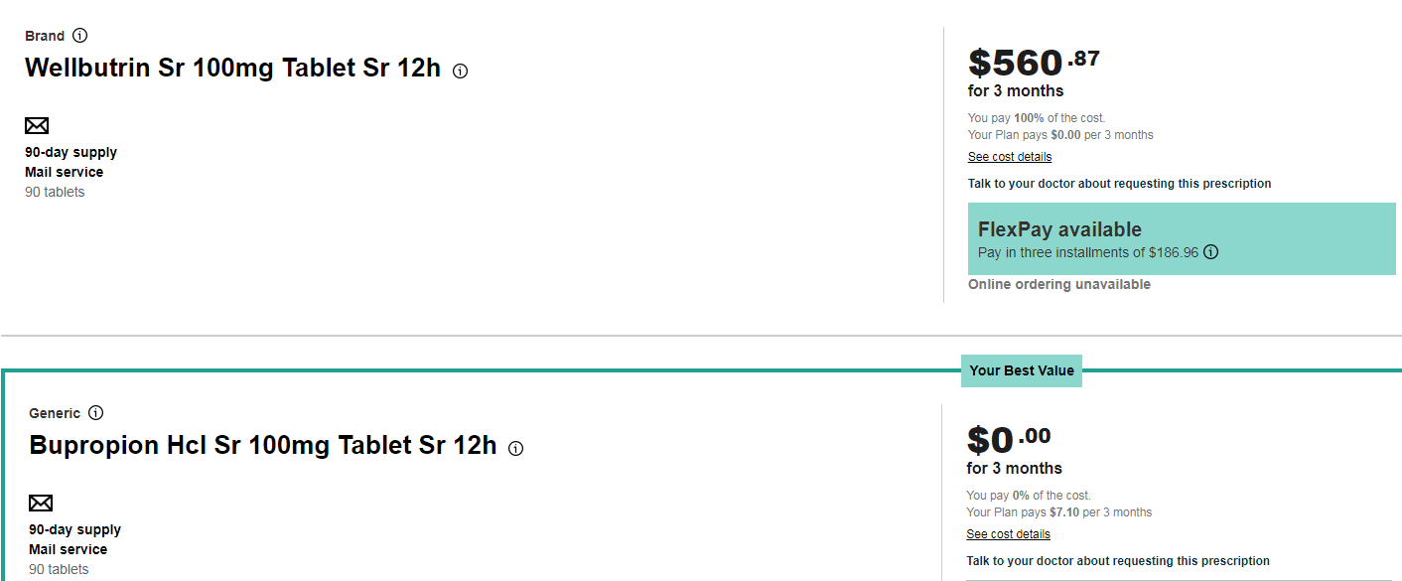
Check drug cost tool
You can check the cost of your medication online at: www.info.caremark.com/trsactivecare
Locate this tool by logging into your account on www.caremark.com. Then select the ‘Check Drug Cost Tool.’
Notes:
You can check the cost of your medication online at info.Caremark.com/trsactivecare. Once online, there are links for each plan. Select the link for plan you would like the price the drug for. Then type in the name of the medication you would like to search. Merely start typing the medication name, and a list of medications will populate to choose from. Select the medication and dosage you intend to search, and the tool will price the medication for you. If the medication has a generic available, and you searched for a brand name medication, the generic equivalent will appear below the brand.
For this example, I selected, the HD plan. I searched for Wellbutrin, which is used to treat depression. The brand name is quite costly, while the generic medication is $0, since it is on the Generic Preventive Medication List.
Be advised that the price of the drug can vary over several months.

Slide 50

Diabetic meter and supplies
Up to a 31-Day Supply at Retail Pharmacy | 90-Day Supply at Retail-Plus Network Pharmacy or Caremark Mail Order Pharmacy
You pay $0 for needles and syringes if purchased the same day as insulin. | You pay $0 for all needles, lancets and syringes, regardless of manufacturer To obtain test strips at no cost, you must use the preferred brand
Preferred Diabetic Meters are available at no cost to eligible to you.
For more details, please contact CVS Caremark Diabetic Meter Program at 1-800-588-4456
Notes:
You are eligible for a diabetic meter at no cost to them. You would just need to contact the Diabetic Meter Team to obtain their meter.
Note that the current preferred brand is AccuChek at this time. For more details on the AccuChek meter, please contact the Diabetic Meter Team.

Slide 51
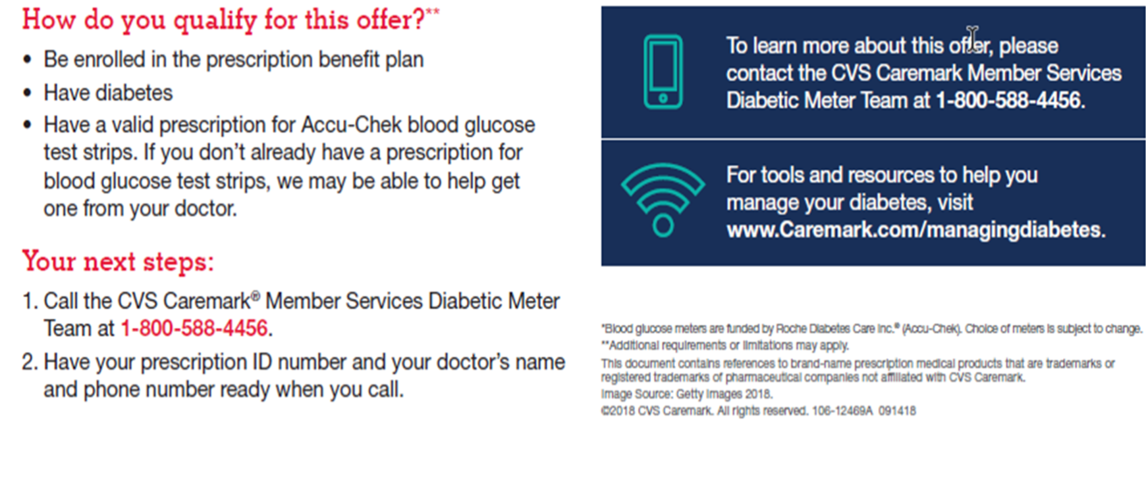
No-cost diabetes accu-check blood glucose meter
Notes:
Here is more information on the Diabetic Meter Program.

Slide 52
Access to id cards
CVS Caremark App
Log into your account and have your ID card at the palm of your hand.
www.caremark.com
  Log into www.caremark.com and print your ID card.
Caremark Customer Care
  Employees can contact a Customer Care Representative at 1-866-355-5999.
Notes:
There are many way to access your ID card. You can pull it up on the CVS Caremark mobile app, log into your Caremark.com account, or call our Customer Care team. Our Customer Care team is available 24/7 and are designated for TRS participants.

Slide 53
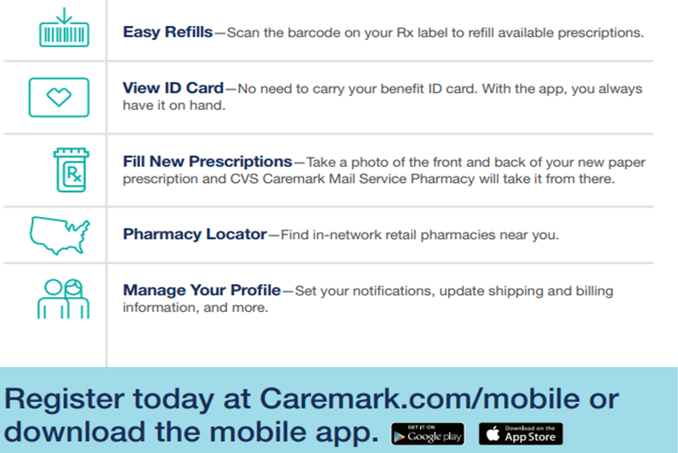

Manage your prescription benefit anywhere, anytime
Download the CVS Caremark app for on-the-go access to helpful tool and resources
Notes:
Download the CVS Caremark® mobile app and manage your prescription medications from wherever you are. You can order refills, check drug costs, view your prescription ID card and locate a pharmacy – anytime, anywhere.

Slide 54
Scott & White Care PLan
Central and North Texas

Slide 55
Welcome to Scott & White Care Plans
Now including FirstCare Health Plans
What that means for you:
  Access to thousands of providers throughout Central Texas
  In-network coverage from doctors, specialists and facilities of the Baylor Scott & White Health system
  No referral needed to see in-network specialists
Notes:
Scott and White now include FirstCare Health plans which means more access to care for you.

Slide 56

A Texas Company
Specializing in Texas health insurance plans since 1982
Serving 140 Texas counties
Offices in Abilene, Amarillo, Austin, Dallas, Lubbock and Waco; Corporate headquarters in Temple
Joined TRS‐ActiveCare program in 2007
Currently cover 47,000+ school employees and their dependents

Slide 57
Our Mission: Promote the well-being of all individuals, families and communities
Our Ambition: To be the trusted leader, educator and innovator in value-based care delivery, customer experience and affordability.
Our Goal: To engage you in your own care and give you tools and resources you need

Slide 58

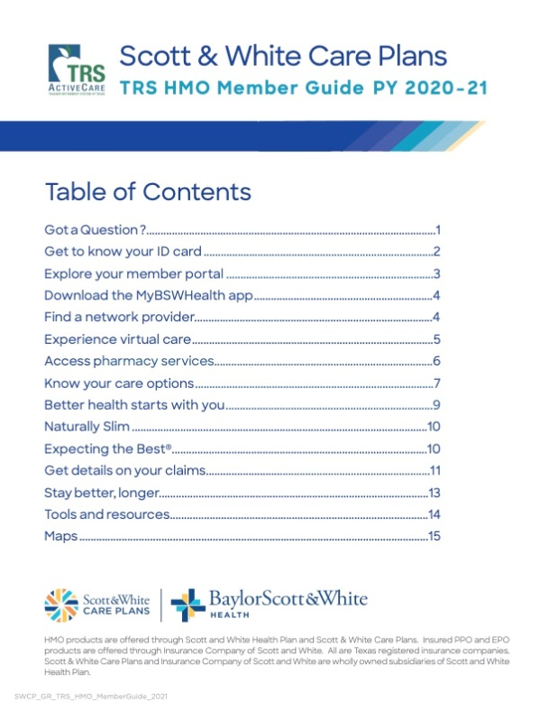
trs.swhp.org
Your one-stop shop for benefits information
Notes:
Trs.swhp.org is your one stop shop for all things related to your Scott and White health care benefits

Slide 59
Benefit Highlights for 2020-21
100% preventive care coverage
Low deductible option
Access to virtual care options—like eVisits and video visits—for
a $0 copay
First in-person sick visit $0 copay
No copay for PCP visits for dependents under age 19
Maximum out-of-pocket includes medical and prescription drug deductibles, copays and coinsurance
For additional plan information, see the Members’ page at trs.swhp.org
Notes:
Scott and White offers a 100% coverage for preventive care, low deductible option, $0 virtual health care, $0 first in-person sick visits and no copays for PCP visits for dependents under 19.

Slide 60
Benefit Highlights for 2020-21 (Cont.)
No referrals needed for in-network physicians
Comprehensive network of quality physicians
Local offices; Texas-based customer service
Worldwide emergency care
Digital wellness coaching available to all members
Naturally Slim® available to all members
Expecting the Best™ maternity program
For additional plan information, see the Members’ page at trs.swhp.org
Notes:
There are no referrals needed for in-network physicians
Scott and White has a comprehensive network of quality physicians
Members have access to worldwide emergency care
Digital wellness coaching available to all members
Members have access to the Naturally Slim® wellness program
Members also have access to Expecting the Best™ maternity program

Slide 61
Virtual Care at $0 copay
MyBSWHealth
  eVisits - Online diagnosis and treatment plan for common medical conditions
  Video Visits - Online with a doctor, face-to-face in real time
  Both available at MyBSWHealth.com or the MyBSWHealth app
MDLIVE
  Talk to doctors, licensed therapists and more, for general health and behavioral health concerns.
  Visit by phone, secure video, or the MDLIVE app
Notes:
Virtual care is $0 through MDLive and MyBSWHealth eVisits

Slide 62
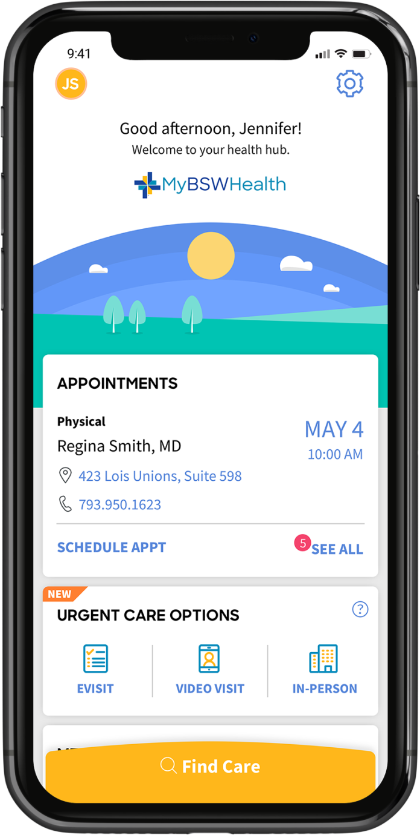
Healthcare in a snapp
Be sure to link your account in the app:
Tap the gear icon in the top right corner
Tap “Manage Linked Accounts”
Tap “Link Account”
Enter member information
Notes:
Be sure to link your Scott and White Health Plan account in the MyBSWHealth app so your claim can be properly processed.

Slide 63



Naturally Slim
A unique mindful-eating curriculum combined with technology to teach people the skills needed to sustainably lose weight and improve their health—while eating foods they love.
NO COST to SWCP TRS members
NO WAITING for a class to form
Accessible via computer and mobile device
Learn more at trs.swhp.org

Slide 64
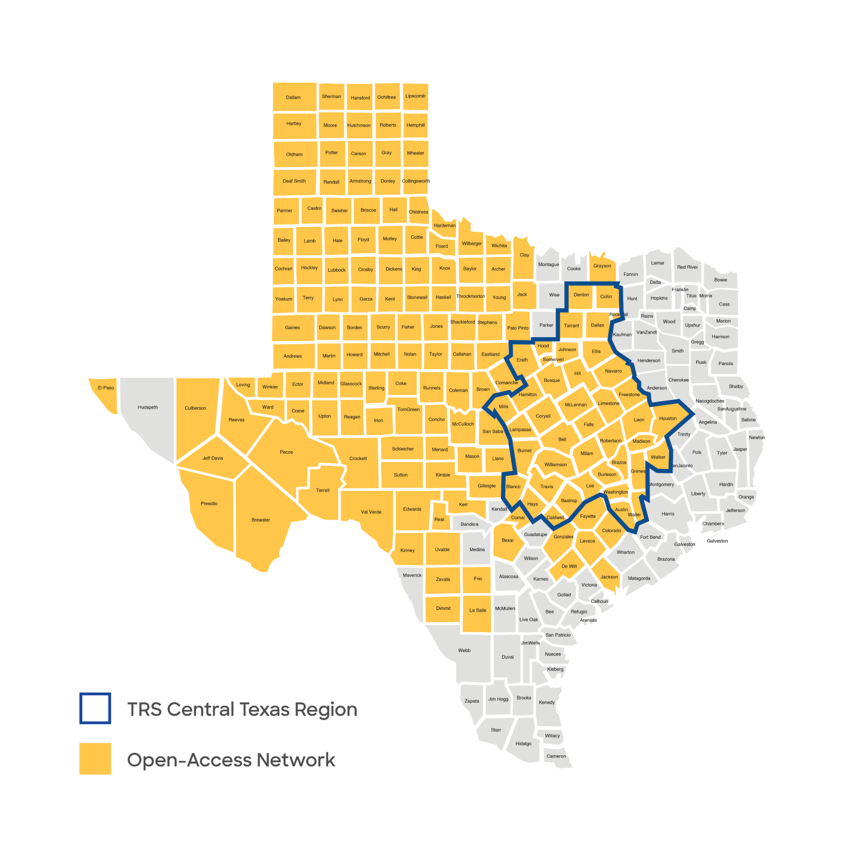
TRS
Central Texas Region
TRS
Central Texas Region
Notes:
If you live or work in TRS’s Central Texas Region you can choose the Scott & White Care Plans HMO for 2020-2021. This is our largest network within Texas. You’ll find a copy of this map and a list of the counties on the Members page at trs.swhp.org.

Slide 65

Medical coverage overview
2020-21
Deductible $950 per individual / $2,850 per family
Out-of-Pocket Maximum Includes medical/drug deductible, copayments & coinsurance $7,450 per individual / $14,900 per family
Office Visit Primary Care: $20 ($0 for first sick visit) Primary Care for Dependents (age 19 and under): $0 Specialist Visits: $70
Inpatient/Outpatient Services 20% after deductible (member share)
Preventive Care $0 with no deductible
NO PCP copay for first sick visit
NO PCP copay for dependents (age 19 and under)
Notes:
As you can see, the benefits are the same as last year.

Slide 66
2020-21 Premium Information
Coverage Category | 2020-21 Premiums
Employee Only | $551.10
Employee and Spouse | $1,382.06
Employee and Child(ren) | $883.50
Family | $1,478.56
For detailed plan information, see the Members’ page at trs.swhp.org
Notes:
Note to BA: Please fill in your district’s applicable district contribution before presenting to your employees.
The premiums for the 2020-21 Scott and White plan can be seen here.

Slide 67

Pharmacy Coverage Overview
$0 copay on
ACA Preventive Medications
2020-21
RX Deductible $150 per individual (ACA Preventive and Preferred Generics excluded) Rx
Rx Out-of-Pocket Maximum Included in plan’s Out-of-Pocket Maximum
Retail 30-Day Supply ACA Preventive: $0 Preferred Generics: $5 Preferred Brand: 30% after Rx deductible Non-preferred Brand / Non-preferred Generics: 50% after Rx deductible Specialty Medications Tier 1 and 2: 15% after Rx deductible Tier 3: 25% after Rx deductible

Slide 68
Resources for Reducing Healthcare Costs
Emergency Room (ER) – should only be used when a person’s life is in danger or if waiting may cause a loss of function of a body part, organ or system
Urgent Care Clinics – when you can’t wait until the next day or your doctor’s office is closed
Virtual Care - $0 copay including Baylor Scott & White eVisits and video visits, plus additional services powered by MDLIVE
Generic Medications – use when available and/or order a 90-day supply to save time and money
Stay In-Network – in-network doctors have agreed to accept our payment along with your copayment as the entire cost of their services
Talk to a Nurse - Need care advice? Should you see a doctor? Get the info you need today! See the back of your ID card for additional information
Notes:
To help in reducing healthcare costs you have the following resources like Urgent Care clinics, Virtual Care at a $0 copay with Baylor Scott and White eVisits and video visits, plus additional services powered by MDLIVE, 90-day supply for generic medication when available to save time and money, talk to a Nurse for need care advise, and in network doctors have agreed to accept our payment along with your copayment as the entire cost of their services so you will want to stay In-Network so that you can receive services at a contracted cost. If you have a life-threatening issue, please utilize the Emergency Room services.

Slide 69



MyBSWHealth Website / App
Just a download away:
Find a provider
Send a secure message
See copays, track deductible and out-of-pocket max
Pay bills and track claims
View test results and past visit summaries
Experience eVisits or video visits
Manage and refill prescriptions
View your digital ID card
Notes:
There’s a wealth of online information, resources, and functions available 24/7 in the MyBSWHealth website and App. This list is just a few of the things you can do from your computer or mobile device.
You’ll find more information about the app and website in the 2020-21 Benefits Guide, available on the Member’s page at trs.swhp.org.

Slide 70
Why Choose SWHP?
NO out-of-pocket costs for preventive care service
NO primary care copays for dependents age 19 and under
NO referrals required
Telehealth: MyBSWHealth, MDLIVE and Nurse Advice Line
Wellness: Online coaching, Naturally Slim and Expecting the Best
Texas-based customer service
Worldwide emergency care
Dedicated website
Claims and benefit information available 24/7

Slide 71
Contact Us
CALL Customer Service: 800-321-7947
MESSAGE through the member portal: trs.swhp.org
TRS website: trs.texas.gov/Pages/healthcare_trs_activecare.aspx

Slide 72



BLUE ESSENTIALS South Texas HMO
South Texas

Slide 73

Why blue Essentials?
Delivering Value, Focusing on Quality
AFFORDABILITY
A cost-effective network of select providers at a lower cost than a traditional PPO
ACCESS
The statewide Blue Essentials network offers participants access without compromising benefits, quality or services.
MEMBER ENGAGEMENT
Web and mobile tools such as Provider Finder® help guide decision-making.
Notes:
Why a need for a more affordable network option? According to the U.S. Department of Health & Human Services, health care expenditures are expected to hit more than $3.3 trillion this year, averaging out to more than $10,000 per person. Projections suggest that spending will continue at higher rates than in recent years, more than 5 percent per year on a per-capita basis, and consistently outpace U.S. economic growth.
What’s more, medical costs for employers in the U.S. are expected to increase 6.5 percent for 2018. And, according to the Kaiser 2017 Employer Health Benefits Survey, the average family premium has increased 19% since 2012 and a whopping 55 percent since 2007’s average premium.
Lowering spending for hospital and physician care plays a key role in reducing medical costs. Hospital care accounts for 31% of overall health care spending. Physician services account for 22% of overall health care spending. (Effects of Health Care Spending, U.S. Department of Health and Human Services)
To address these trends, Blue Cross and Blue Shield of Texas (BCBSTX) offers Blue Essentials, an affordable health coverage option that can help reduce your health care costs while still offering your employees access to a statewide network of health care providers. To support members, BCBSTX offers many tools to help them make more-informed decisions and to make the most of their benefits.

Slide 74

blue Essentials
Participants with Blue Essentials select a primary care provider (PCP) who coordinates care with referrals to specialists.
Participants enjoy:
Affordable, predictable costs
Patient-centric, PCP-guided care
Access to a statewide network of high-
quality health care providers
100% coverage of recommended routine preventive care and screenings
Self-service tools that support decision-making when it comes to selecting a provider, using benefits and understanding treatment costs
www.bcbstx.com/trshmo
Notes:
The HMOs of BCBSTX believe that health care decisions are best made between members and their doctors, that physician-guided care promotes sound health care decisions.
With Blue EssentialsSM, members partner with their PCP to coordinate quality, cost-effective care. The PCP provides preventive and primary care as well as referrals to a specialist when needed. HMO Members benefit from physician-guided care to help them manage their health.

Slide 75
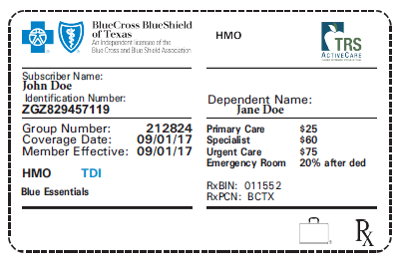
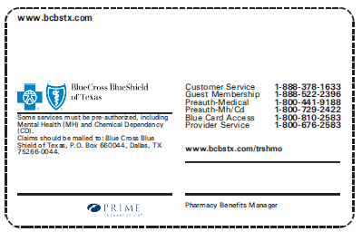
ID CARDS MAILED TO YOUR HOME
  All HMO participants will receive new cards.
  Each individual covered under the plan will receive a card.
  Extra ID cards can be requested, free of charge.
  There will be one card for both Medical and Pharmacy
  The effective date printed on the cards will be 09/01/2020
Participants should expect to receive new cards around late-August.
Participants who make changes after the new cards are mailed will get a second set of cards.
Notes:
All HMO participants will receive new cards
Each individual covered under the plan will receive a card
Extra ID cards can request free of charge
One card for both Medical and Pharmacy
The effective dates printed on the cards will be the more
Effective date with the plan or 9/1/20.
Participants should expect to receive new cards around late-August.
Participants making changes after the replacements have been mailed will result in a second set of cards being sent.

Slide 76

Simple, affordable and easy to use
Patient-Centered, Physician-Guided Care
Blue EssentialsSM SOUTH TEXAS HMO
Deductible | $500 Individual/$1,000 Family
Out-of-Pocket Maximum (Applies to both medical and pharmacy) | $4,500 Individual/$9,000 Family
Office Visits Primary/Specialist | $25 Copay/$60 Copay
Preventive Care | 100%
Emergency Room Copayment | After deductible, plan pays 80%; you pay 20%
Urgent Care Copayment | $75 Copay
Outpatient | After deductible, plan pays 80%; you pay 20%
Inpatient Copayment | After deductible, plan pays 80%; you pay 20%
Pharmacy | $100 Copay per Member Generic: $10 Retail; $30 Mail Order Preferred: $40 Retail; $120 Mail Order Non-Preferred: $60 Retail; $195 Mail Order
Notes:
Medical and Pharmacy benefits remain the same for South Texas HMO

Slide 77
Monthly premium rates 2020-21
SOUTH TEXAS HMO
Coverage Category | 2020-21
Employee Only | $491.54
Employee and Spouse | $1182.52
Employee and Child(ren) | $766.96
Family | $1258.52
Notes:
Note to BA: Please fill in your district’s applicable district contribution before presenting to your employees.
Employee Rates

Slide 78
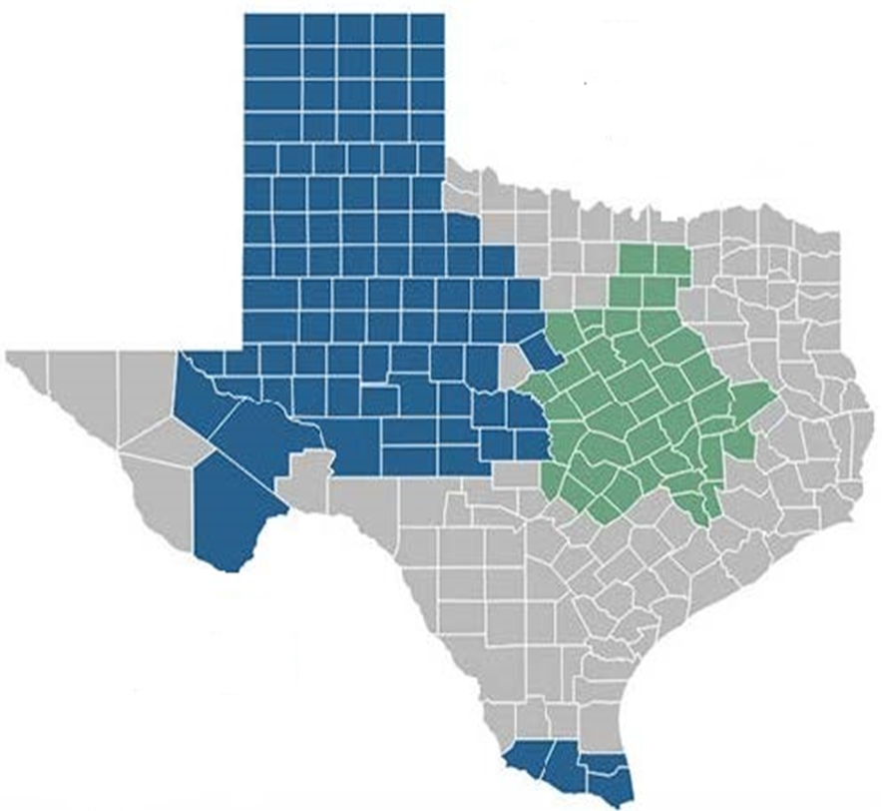
SOUTH TEXAS HMO
Available to employees living,
working or residing in the
following counties:
  Cameron
  Hidalgo
  Starr
  Willacy
Provider Network
  Blue Essentials
Provider Finder
  Blue Essential network providers can
  be found online at:
  www.bcbstx.com/trshmo
SOUTH
Notes:
Available to employees living,
working or residing in the
following counties:
Cameron
Hidalgo
Starr
Willacy
Provider Network
Blue Essentials
Provider Finder
Blue Essential network providers can
be found online at:
www.bcbstx.com/trshmo

Slide 79
PROVIDER FINDER AND ONLINE RESOURCES

Slide 80
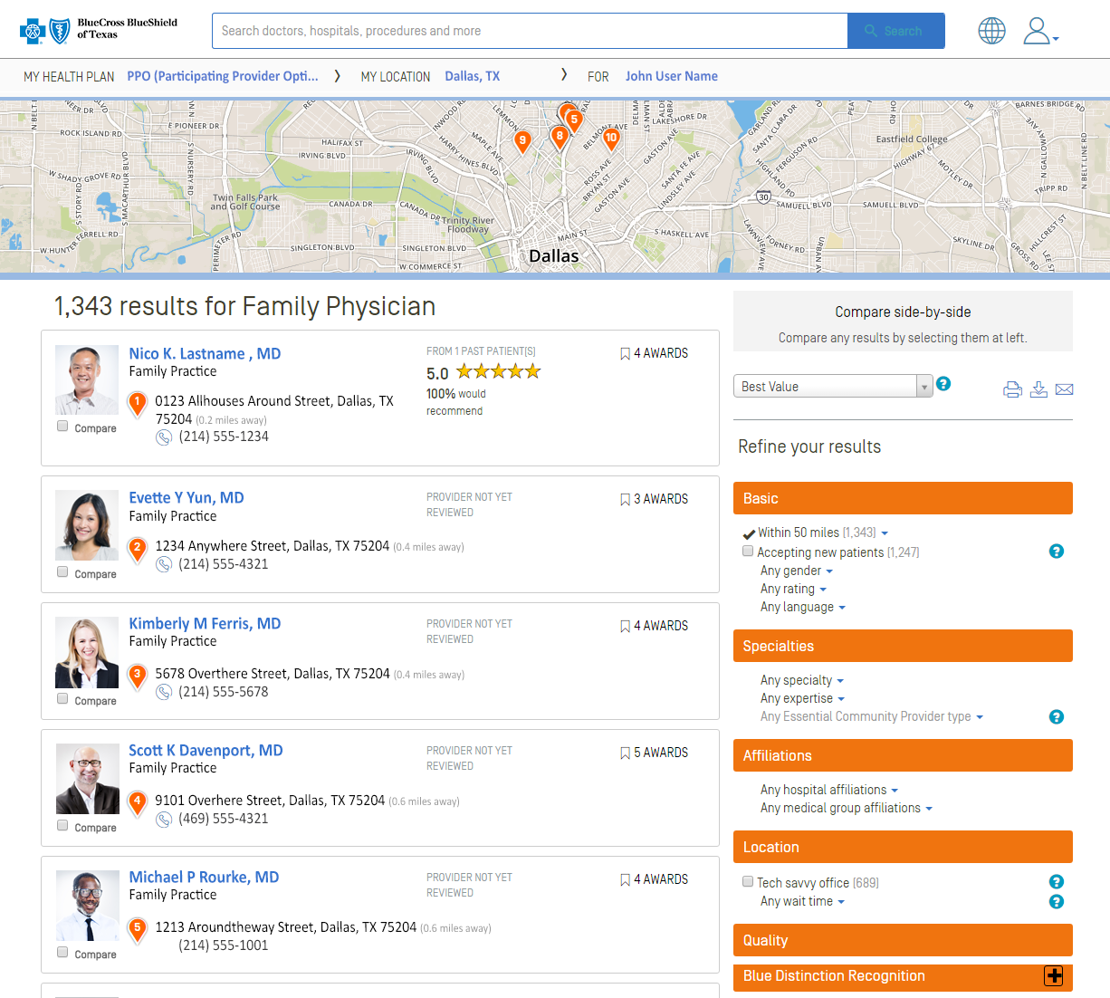
Find Doctors … Fast
1
Refine results with
side-by-side comparison
Advanced demographics information such as doctor photos and highlights help members feel at ease when choosing providers
View what other members think about the doctor
Further refine your search to find the most pertinent providers
Blue Essentials
JohnDoe1
2
1
3
4
3
4
2
www.bcbstx.com/trshmo
Notes:
Provider Finder is our Internet-based provider directory and heath care decision support tool. Members can search for a doctor and also get information about cost, quality and other patients’ experiences all in one place.
To find a network doctor or hospital, members just visit bcbstx.com and log in to Blue Access for Members. You can search by name or specialty to see a list of relevant physicians along with their rating based on patient reviews, if available. Use the dropdown box to sort again by distance, alphabetical order or rating. Members can also further refine a search using the options on the right, such as gender, language or distance. Click the box to the right of each listing to compare up to 10 selected providers side-by-side.

Slide 81

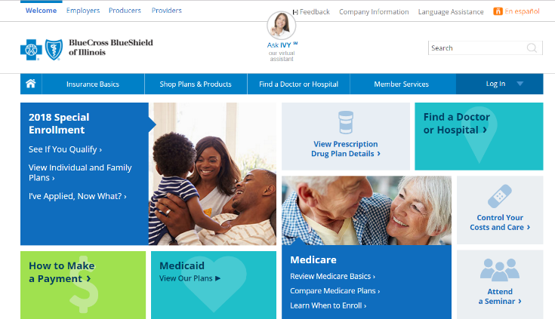

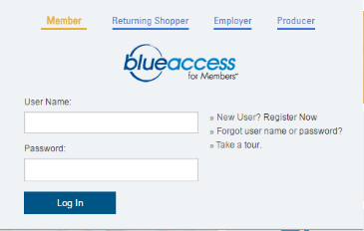















Online Tools and Resources
ID Card Management
Mobile Preferences
Benefits and Claims
Blue Access
for MembersSM
eCards for Health®
Provider Finder®
Member Care Profile
Claim History and
Health Snapshot
Special Beginnings®
Member Wellness
Portal
Blue365® Discount Program
Health Assessment
www.bcbstx.com/trshmo
Notes:
When members log in to Blue Access for Members, BAM, not only can you find doctors and compare costs, you have access to a number of other features that help them manage their health and benefits. Here’s a quick snapshot of some of the health and wellness tools and resources available to help members make the right health care decisions for themselves and their families. For example, members can:
Check the status of a claim and claims history
Check benefits and coverage information
Confirm which family members are covered on their plan
View/print Explanation of Benefits (EOB) for a claim
Opt to receive EOBs electronically
Access Health and Wellness tools and resources
Set preferences to receive notifications for claims status and wellness updates through emails or text alerts
Request new or replacement member ID card or print a temporary ID card and Verification of Coverage Letter
Join Connect, our online member community
You can access many features wherever you are from their mobile phone. And connect with us on Facebook, Twitter and YouTube.

Slide 82
Notes:
A Path to Wellness
Reach your goals with the Well onTarget® online portal or mobile app. Complete self-paced programs to help improve long-term health issues and your overall wellbeing. Plus, get one-on-one support from a health coach and rewards for healthy activities.1
Fitness at Home and on the Road
Choose gyms from a large, national network, so you can exercise wherever life takes you. Plus, enjoy savings on acupuncture, massage and personal training.2
Quick Answers to Health Questions
Should you go to the emergency room? Urgent care? Wait to see your doctor? 24/7 Nurseline can help you decide — any day, any time.3
Behavioral Health Support
Your mental health is vital to your wellbeing. Your plan gives you access to treatment options to help with anxiety, depression, substance use and more. Click the Doctors & Hospitals tab in BAM to find a behavioral health provider.
Guidance for Your Growing Family
If youʼre ready to start a family or already expecting, check out apps from Ovia Health®.4 They include expert advice to support you through all the stages of planning for and having a baby.

Slide 83

BlueCard® Access
Employees traveling outside of Texas who need urgent care can receive coverage for care through a BCBS-affiliated provider.
Away from Home Care®
Employees and covered dependents temporarily residing outside of Texas may be eligible to obtain covered
services from a BCBS-affiliated HMO.
Notes:
BlueCard: Employees traveling outside of Texas who need urgent care will have access to BlueCard. This program gives them the ability to obtain health care services through a BCBS-affiliated physician or hospital outside of Texas.
Away From Home Care: Under the Away From Home Care program, employees (or covered dependents) who will be temporarily residing outside of Texas, in a participating location, for at least 90 days, may be eligible to obtain covered services from a BCBS-affiliated HMO.

Slide 84


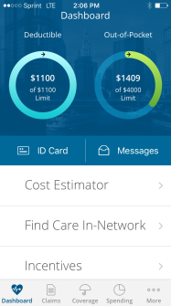


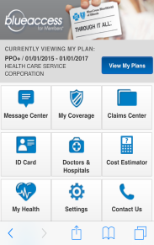
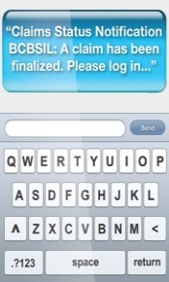


Increase Member Engagement with
Blue Access MobileSM
PUBLIC SITE
No log-in required
Insurance basics
Find network providers
Log-in or register for
Blue Access for MembersSM
Contact us
BCBSTX APP
Quick access to member claims, coverage, ID information and more
Ability to email your ID or send to Apple Wallet
Available in English and Spanish
BLUE ACCESS
FOR MEMBERS
Secure Site: log-in required
Digital ID card
Benefits/eligibility
Claims status
User profile
Pay My Bill
My Care Profile
Health and wellness resources
TEXT MESSAGING
Static
Rx reminders, diabetes diet tips, heart health tips, claim status notifications, exercise and fitness tips
Dynamic
ID card management,
coverage management
“Claims Status Notification
BCBSTX: A claim has been finalized. Please log in…”
Notes:
And here are just some of the features that your members can access via their mobile phones:
Public Site – No log-in required
Health Care 101
Find a Doctor or Hospital:
Locate in-network providers by name/specialty, find nearest urgent care by city or ZIP
Blue Access for Members Log-in:
Allows members to log into secure mobile site or register directly from mobile phone
Contact Us:
Phone and mail contact information
Blue Access for Members
Secure Site – Log-in Required
ID Card: Instant digital membership card
Coverage effective date, ID number, member ID
BCBSTX App For iPhone® and Android® phones:
-Locate in-network providers by name/specialty
-Link to map and directions
-Add provider information to contacts
-Locate nearest urgent care facility by ZIP or using phone’s GPS location
iPhone App can be downloaded on the iPad®

Slide 85


BLUE ESSENTIALS – CONTACT US
Personalized, Dedicated Customer Service
  Claim questions/status
  Network provider information
  Medical and pharmacy coverage questions
  ID card requests
  Transition of care information
  Help with online tools
www.bcbstx.com/trshmo
Customer Service
1-888-378-1633
Notes:
Dedicated Customer Service:
Claim questions/status
Network provider information
Medical and Rx coverage questions
ID card requests
Transition of care information
Help with online tools

Slide 86
BLUE ESSENTIALS WEST TEXAS HMO
West Texas

Slide 87
Why blue Essentials?
Delivering Value, Focusing on Quality
AFFORDABILITY
A cost-effective network of select providers at a lower cost than a traditional PPO
ACCESS
The statewide Blue Essentials network offers participants access without compromising benefits, quality or services.
MEMBER ENGAGEMENT
Web and mobile tools such as Provider Finder® help guide decision-making.
Notes:
Why a need for a more affordable network option? According to the U.S. Department of Health & Human Services, health care expenditures are expected to hit more than $3.3 trillion this year, averaging out to more than $10,000 per person. Projections suggest that spending will continue at higher rates than in recent years, more than 5 percent per year on a per-capita basis, and consistently outpace U.S. economic growth.
What’s more, medical costs for employers in the U.S. are expected to increase 6.5 percent for 2018. And, according to the Kaiser 2017 Employer Health Benefits Survey, the average family premium has increased 19% since 2012 and a whopping 55 percent since 2007’s average premium.
Lowering spending for hospital and physician care plays a key role in reducing medical costs. Hospital care accounts for 31% of overall health care spending. Physician services account for 22% of overall health care spending. (Effects of Health Care Spending, U.S. Department of Health and Human Services)
To address these trends, Blue Cross and Blue Shield of Texas (BCBSTX) offers Blue Essentials, an affordable health coverage option that can help reduce your health care costs while still offering your employees access to a statewide network of health care providers. To support members, BCBSTX offers many tools to help them make more-informed decisions and to make the most of their benefits.

Slide 88
blue Essentials
Participants with Blue Essentials select a primary care provider (PCP) who coordinates care with referrals to specialists.
Participants enjoy:
Affordable, predictable costs
Patient-centric, PCP-guided care
Access to a statewide network of high-
quality health care providers
100% coverage of recommended routine preventive care and screenings
Self-service tools that support decision-making when it comes to selecting a provider, using benefits and understanding treatment costs
www.bcbstx.com/trshmo
Notes:
The HMOs of BCBSTX believe that health care decisions are best made between members and their doctors, that physician-guided care promotes sound health care decisions.
With Blue EssentialsSM, members partner with their PCP to coordinate quality, cost-effective care. The PCP provides preventive and primary care as well as referrals to a specialist when needed. HMO Members benefit from physician-guided care to help them manage their health.

Slide 89
ID CARDS MAILED TO YOUR HOME
  All HMO participants will receive new cards.
  Each individual covered under the plan will receive a card.
  Extra ID cards can be requested, free of charge.
  There will be one card for both Medical and Pharmacy
  The effective date printed on the cards will be 09/01/2020
Participants should expect to receive new cards around late-August.
Participants who make changes after the new cards are mailed will get a second set of cards.
Notes:
All HMO participants will receive new cards
Each individual covered under the plan will receive a card
Extra ID cards can request free of charge
One card for both Medical and Pharmacy
The effective dates printed on the cards will be the more
Effective date with the plan or 9/1/20.
Participants should expect to receive new cards around late-August.
Participants making changes after the replacements have been mailed will result in a second set of cards being sent.

Slide 90
Simple, affordable and easy to use
Patient-Centered, Physician-Guided Care
Blue EssentialsSM WEST TEXAS HMO
Annual Deductible | $950 Individual/$2,850 Family
Out-of-Pocket Maximum (Applies to both medical and pharmacy) | $7450 Individual/$14,900 Family
Office Visits Primary/Specialist | $20 Copay/ $70 Copay
Preventive Care | 100%
Emergency Room Copay | $500 Copay; 25% after deductible
Urgent Care Copay | $50 Copay per visit
Outpatient | $500 Deductible; 25% after deductible is met
Inpatient | $500 Deductible; 25% after deductible is met
Pharmacy | $150 Deductible Generic: $5 Retail/$12.50 Mail Order Preferred Brand: 30% after Pharmacy Deductible Non-Preferred Brand: 50% after Pharmacy Deductible

Slide 91
Monthly Premium Rates 2020-21
WEST TEXAS HMO
Coverage Category | 2020-21
Employee Only | $534.42
Employee and Spouse | $1287.58
Employee and Child(ren) | $835.68
Family | $1370.12
Notes:
Note to BA: Please fill in your district’s applicable district contribution before presenting to your employees.
Employee Rates

Slide 92
WEST TEXAS HMO
Available to employees living, working or residing in the
following counties:
Andrews, Armstrong, Bailey, Borden, Briscoe, Callahan,
Carson, Castro, Childress, Cochran, Coke, Coleman, Collingsworth, Comanche, Concho, Cottle, Crane, Crockett, Crosby, Dallam, Dawson, Deaf Smith, Dickens, Donley, Eastland, Ector, Fisher, Floyd, Gaines, Garza, Glasscock, Gray, Hale, Hall, Hansford, Hartley, Haskell, Hemphill, Hockley, Howard, Hutchinson, Irion, Jones, Kent, Kimble, King, Knox, Lamb, Lampasas, Lipscomb, Loving, Lubbock, Lynn, Martin, Mason, McCulloch, Midland, Mitchell, Moore, Motley, Nolan, Ochiltree, Oldham, Parmer, Pecos, Potter, Randall, Reagan, Reeves, Roberts, Runnels, San Saba, Scurry, Schleicher, Shackelford, Sherman, Stephens, Sterling, Stonewall, Sutton, Swisher, Taylor, Terry, Throckmorton, Tom Green, Upton, Ward, Wheeler, Winkler, Yoakum (New Counties)
Provider Network
  Blue Essentials
Provider Finder
  A complete list of network providers is available at:
WEST
www.bcbstx.com/trshmo
Notes:
Available to employees living, working or residing in the
following counties:
Andrews, Armstrong, Bailey, Borden, Briscoe, Callahan,
Carson, Castro, Childress, Cochran, Coke, Coleman, Collingsworth, Comanche, Concho, Cottle, Crane, Crockett, Crosby, Dallam, Dawson, Deaf Smith, Dickens, Donley, Eastland, Ector, Fisher, Floyd, Gaines, Garza, Glasscock, Gray, Hale, Hall, Hansford, Hartley, Haskell, Hemphill, Hockley, Howard, Hutchinson, Irion, Jones, Kent, Kimble, King, Knox, Lamb, Lampasas, Lipscomb, Loving, Lubbock, Lynn, Martin, Mason, McCulloch, Midland, Mitchell, Moore, Motley, Nolan, Ochiltree, Oldham, Parmer, Pecos, Potter, Randall, Reagan, Reeves, Roberts, Runnels, San Saba, Scurry, Schleicher, Shackelford, Sherman, Stephens, Sterling, Stonewall, Sutton, Swisher, Taylor, Terry, Throckmorton, Tom Green, Upton, Ward, Wheeler, Winkler, Yoakum (New Counties)
Provider Network
Blue Essentials
Provider Finder
A complete list of network providers is available at: www.bcbstx.com/trshmo

Slide 93
PROVIDER FINDER AND ONLINE RESOURCES

Slide 94
Find Doctors … Fast
1
Refine results with
side-by-side comparison
Advanced demographics information such as doctor photos and highlights help members feel at ease when choosing providers
View what other members think about the doctor
Further refine your search to find the most pertinent providers
Blue Essentials
JohnDoe1
2
1
3
4
3
4
2
www.bcbstx.com/trshmo
Notes:
Provider Finder is our Internet-based provider directory and heath care decision support tool. Members can search for a doctor and also get information about cost, quality and other patients’ experiences all in one place.
To find a network doctor or hospital, members just visit bcbstx.com and log in to Blue Access for Members. You can search by name or specialty to see a list of relevant physicians along with their rating based on patient reviews, if available. Use the dropdown box to sort again by distance, alphabetical order or rating. Members can also further refine a search using the options on the right, such as gender, language or distance. Click the box to the right of each listing to compare up to 10 selected providers side-by-side.

Slide 95
Online Tools and Resources
ID Card Management
Mobile Preferences
Benefits and Claims
Blue Access
for MembersSM
eCards for Health®
Provider Finder®
Member Care Profile
Claim History and
Health Snapshot
Special Beginnings®
Member Wellness
Portal
Blue365® Discount Program
Health Assessment
www.bcbstx.com/trshmo
Notes:
When you log in to Blue Access for Members, BAM, not only can you find doctors and compare costs, you have access to a number of other features that help them manage their health and benefits. Here’s a quick snapshot of some of the health and wellness tools and resources available to help members make the right health care decisions for themselves and their families. For example, members can:
Check the status of a claim and claims history
Check benefits and coverage information
Confirm which family members are covered on their plan
View/print Explanation of Benefits (EOB) for a claim
Opt to receive EOBs electronically
Access Health and Wellness tools and resources
Set preferences to receive notifications for claims status and wellness updates through emails or text alerts
Request new or replacement member ID card or print a temporary ID card and Verification of Coverage Letter
Join Connect, our online member community
Members can access many features wherever you are from your mobile phone. And connect with us on Facebook, Twitter and YouTube.

Slide 96
Notes:
A Path to Wellness
Reach your goals with the Well onTarget® online portal or mobile app. Complete self-paced programs to help improve long-term health issues and your overall wellbeing. Plus, get one-on-one support from a health coach and rewards for healthy activities.1
Fitness at Home and on the Road
Choose gyms from a large, national network, so you can exercise wherever life takes you. Plus, enjoy savings on acupuncture, massage and personal training.2
Quick Answers to Health Questions
Should you go to the emergency room? Urgent care? Wait to see your doctor? 24/7 Nurseline can help you decide — any day, any time.3
Behavioral Health Support
Your mental health is vital to your wellbeing. Your plan gives you access to treatment options to help with anxiety, depression, substance use and more. Click the Doctors & Hospitals tab in BAM to find a behavioral health provider.
Guidance for Your Growing Family
If youʼre ready to start a family or already expecting, check out apps from Ovia Health®.4 They include expert advice to support you through all the stages of planning for and having a baby.

Slide 97
BlueCard® Access
Employees traveling outside of Texas who need urgent care can receive coverage for care through a BCBS-affiliated provider.
Away from Home Care®
Employees and covered dependents temporarily residing outside of Texas may be eligible to obtain covered
services from a BCBS-affiliated HMO.
Notes:
BlueCard: Employees traveling outside of Texas who need urgent care will have access to BlueCard. This program gives them the ability to obtain health care services through a BCBS-affiliated physician or hospital outside of Texas.
Away From Home Care: Under the Away From Home Care program, employees (or covered dependents) who will be temporarily residing outside of Texas, in a participating location, for at least 90 days, may be eligible to obtain covered services from a BCBS-affiliated HMO.

Slide 98
Increase Member Engagement with
Blue Access MobileSM
PUBLIC SITE
No log-in required
Insurance basics
Find network providers
Log-in or register for
Blue Access for MembersSM
Contact us
BCBSTX APP
Quick access to member claims, coverage, ID information and more
Ability to email your ID or send to Apple Wallet
Available in English and Spanish
BLUE ACCESS
FOR MEMBERS
Secure Site: log-in required
Digital ID card
Benefits/eligibility
Claims status
User profile
Pay My Bill
My Care Profile
Health and wellness resources
TEXT MESSAGING
Static
Rx reminders, diabetes diet tips, heart health tips, claim status notifications, exercise and fitness tips
Dynamic
ID card management,
coverage management
“Claims Status Notification
BCBSTX: A claim has been finalized. Please log in…”
Notes:
And here are just some of the features that your members can access via their mobile phones:
Public Site – No log-in required
Health Care 101
Find a Doctor or Hospital:
Locate in-network providers by name/specialty, find nearest urgent care by city or ZIP
Blue Access for Members Log-in:
Allows members to log into secure mobile site or register directly from mobile phone
Contact Us:
Phone and mail contact information
Blue Access for Members
Secure Site – Log-in Required
ID Card: Instant digital membership card
Coverage effective date, ID number, member ID
BCBSTX App For iPhone® and Android® phones:
-Locate in-network providers by name/specialty
-Link to map and directions
-Add provider information to contacts
-Locate nearest urgent care facility by ZIP or using phone’s GPS location
iPhone App can be downloaded on the iPad®

Slide 99
BLUE ESSENTIALS – CONTACT US
Personalized, Dedicated Customer Service
  Claim questions/status
  Network provider information
  Medical and pharmacy coverage questions
  ID card requests
  Transition of care information
  Help with online tools
www.bcbstx.com/trshmo
Customer Service
1-888-378-1633
Notes:
Dedicated Customer Service:
Claim questions/status
Network provider information
Medical and Rx coverage questions
ID card requests
Transition of care information
Help with online tools

Slide 100
Eligibility and Enrollment
Notes:
Welcome to the bswift portion of this training. We know you have heard a great deal of information but we have a few more important things to include for you.

Slide 101
Who is eligible to enroll?
To be ELIGIBLE for TRS-ActiveCare coverage, you must:
Be employed by a participating district/entity and
Be an active, contributing TRS member or
Be employed 10 or more regularly scheduled hours each week
  You are INELIGIBLE for TRS-ActiveCare coverage if you*:
  Are receiving health care coverage as an employee or retiree under
Texas State College and University Employees Uniform Insurance Benefits Act (e.g., coverage offered by The University of Texas System or the Texas A & M University System)
Texas Employees Uniform Group Insurance Benefits Act (e.g., coverage offered by ERS)
TRS-Care.
  *Note they can be covered as dependents of
  eligible employees
Notes:
Who can enroll in TRS-ActiveCare?
To be eligible for TRS-ActiveCare, you must be employed by a participating entity. Then, ask yourself these questions:
(1) Are you an active, contributing TRS member?
(2) Are you employed for 10 or more regularly scheduled hours each week?
If the answer is yes to either question, then you are eligible for TRS-ActiveCare coverage.
Employees that are not eligible to enroll in TRS-ActiveCare include individuals:
•
•Receiving health care coverage as an employee or retiree under the Texas State College and University Employees Uniform Insurance Benefits Act, for example, a school employee that has UT SELECT coverage as an employee with The University of Texas System.
•Receiving health care coverage as an employee or retiree under the Texas Employee Uniform Group Insurance Benefits Act, for example, a school employee that has HealthSelect coverage as an employee with ERS.
•A TRS retiree receiving, or who waived coverage, under TRS-Care, including
a retiree who has returned to work. Note: If a retiree has returned to work and has never been eligible for TRS-Care, he or she would be eligible for TRS-ActiveCare coverage, as long as the retiree meets all the TRS-ActiveCare eligibility requirements.
Basically, employee coverage is not available from two state sources.
However, these individuals–retirees, higher education and state of Texas employees–while they are not eligible to enroll for TRS-ActiveCare coverage as employees, they can be covered as a dependent of an eligible employee.

Slide 102
Employees not eligible to enroll
These individuals are not eligible to enroll for TRS-ActiveCare coverage
as employees, but they can be covered as dependents of
eligible employees.
  State of Texas employees or retirees
  Higher education employees or retirees
  TRS retirees, receiving or who declined coverage under TRS-Care
Notes:
Employees that are not eligible to enroll in TRS-ActiveCare include individuals:
•
•Receiving health care coverage as an employee or retiree under the Texas State College and University Employees Uniform Insurance Benefits Act, for example, a school employee that has UT SELECT coverage as an employee with The University of Texas System.
•Receiving health care coverage as an employee or retiree under the Texas Employee Uniform Group Insurance Benefits Act, for example, a school employee that has HealthSelect coverage as an employee with ERS.
•A TRS retiree receiving, or who waived coverage, under TRS-Care, including
a retiree who has returned to work. Note: If a retiree has returned to work and has never been eligible for TRS-Care, he or she would be eligible for TRS-ActiveCare coverage, as long as the retiree meets all the TRS-ActiveCare eligibility requirements.
Basically, employee coverage is not available from two state sources.
However, these individuals–retirees, higher education and state of Texas employees–while they are not eligible to enroll for TRS-ActiveCare coverage as employees, they can be covered as a dependent of an eligible employee.

Slide 103
Dependent eligibility
Eligible dependent can include:
Spouse, including common law spouse
A child under age 26: a natural child, an adopted child (or a child who is lawfully placed for legal adoption), stepchild, foster child, or child under legal guardianship of the employee
“Any other child” under the age of 26 (unmarried) in a regular parent-child relationship with the employee – must meet residency and support criteria
A grandchild under age 26
Unmarried disabled dependent (age 26+) – must live with employee
A dependent does not include a brother or sister of an employee unless the sibling is an unmarried individual under 26 years of age who is either: (1) under the legal guardianship of the employee, or (2) in a regular parent-child relationship with
the employee and meets the “any other child” criteria
Parents and grandparents of the covered employee do not meet the definition
of an eligible dependent
Notes:
Eligible dependents can include:
A spouse (including a common law spouse)*
A child under the age of 26 such as:
A natural child
An adopted child or a child who is lawfully placed for legal adoption
A stepchild
A foster child
A child under the legal guardianship of the employee
“Any other child” under age 26 (unmarried) in a regular parent-child relationship with the employee (other than a child described in the category immediately above), meaning:
The child's primary residence is the household of the employee;
The employee provides at least 50% of the child's support;
Neither of the child's natural parents resides in that household; and
The employee has the legal right to make decisions regarding the child's medical care
A grandchild under age 26 whose primary residence is the household of the employee and who is a dependent of the employee for federal income tax purposes for the reporting year in which coverage of the grandchild is in effect. For purposes of dependent eligibility under TRS-ActiveCare, a grandchild is not considered a child.
A child of a covered employee, age 26 or over, may be eligible for dependent coverage, provided that the child is either mentally or physically incapacitated to such an extent to be dependent on the employee on a regular basis as determined by TRS, and meets other requirements as determined by TRS.
A dependent does not include a brother or a sister of an employee unless the brother or sister is an unmarried individual under 26 years of age who is either: (1) under the legal guardianship of the employee, or (2) in a regular parent-child relationship with an employee, as defined in the “any other child” category above. Parents and grandparents of the covered employee do not meet the definition of an eligible dependent.
*A common law marriage is not considered a special enrollment event unless there is a Declaration of Common Law led with an authorized government agency.

Slide 104
Special eligibility situations
If an employee and spouse both work for a participating district/entity:
  A spouse may be covered as an employee or as a dependent of an employee
  Only one parent can cover dependent children
A child (under age 26) employed by a district/entity can be covered as a dependent:
  If the child is a contributing TRS member and they are not eligible for split or pooled billing
Notes:
If an employee and spouse both work for a participating district/entity:
Each employee can apply
Each employee can choose employee-only coverage and select the same or different plans
One employee can select employee and spouse coverage, and the spouse must decline coverage
One employee can choose employee-only coverage, and the spouse can choose the same or different plan for employee and child(ren) coverage
One employee can select employee and family coverage, and the spouse must decline coverage
Only one parent may enroll dependent children for coverage.
What if a child works for a participating entity?
A child (under age 26) who is employed by a district/entity can be covered as a dependent on his or her parent's TRS-ActiveCare coverage. Please note: If the child is a contributing TRS member, they are not eligible for split or pooled billing.

Slide 105
Paper submission enrollment

Slide 106
Three steps to enroll
Choose your health plan
Complete an Enrollment Changes and Declination Form available online or from your Benefits Administrator
Sign, date and submit form to your Benefits Administrator
Notes:
Important note: Your current plan election will carry forward to the new plan year. You do not have to actively enroll for coverage this year, UNLESS:
You are newly eligible for coverage.
You are changing plans or adding dependent(s) for the coming plan year.
You want to decline coverage for 2020-21.
In this case, you must enroll or decline for coverage during the enrollment period.

Slide 107
Annual enrollment
Enrollment Period for 2020-21 Plan Year:
July 15– Aug. 21 (Annual Enrollment)
Use the Enrollment Guide and Provider Directories to pick a plan and coverage that is right for you.
  If you select the TRS-ActiveCare Primary, TRS-ActiveCare Primary+ or Blue Essentials (South HMO or West HMO) plans, you will need to select a Primary Care Provider (PCP).
Your current plan election will carry forward to the new plan year (Sept. 1, 2020 through Aug. 31, 2021). You do not have to actively enroll for coverage this year.
Your premium will be adjusted to reflect any rate change, effective Sept. 1, 2020.
Notes:
The plan enrollment period for the 2020-21 plan year is July 15 – Aug. 21, 2020.
You are encouraged to read the enrollment guide and review the plans carefully. Rates and/or benefits for every TRS-ActiveCare plan option have changed.
Your current plan election will carry forward to the new plan year (Sept. 1, 2020 to Aug. 31, 2021). You do not have to actively enroll for coverage this year, UNLESS:
•You are newly eligible for coverage.
•You are changing plans or adding/removing dependent(s) for the coming plan year.
•You want to decline coverage for 2020-21.
In this case, you must enroll or decline for coverage during the enrollment period.
Note to presenter: If selecting the TRS-ActiveCare Primary, TRS-ActiveCare Primary+ or Blue Essentials South or West HMO plans you will need to select a Primary Care Physician (PCP)
Clarification: If you are already enrolled in TRS-ActiveCare and change employment to a new participating district/entity, you need to complete and return a new enrollment form.
Note to Benefits Administrators: If you have a third party vendor administering your Section 125 cafeteria plan, be sure the vendor communicates the processing guidelines correctly to the employees. All changes to TRS-ActiveCare must be submitted to the Benefits Administrator through the bswift Enrollment Portal. Making a change through a third party vendor for a Section 125 cafeteria plan does not automatically generate a change to TRS-ActiveCare.

Slide 108

Ask emma
Emma is your new virtual assistant.
Emma will help you select the best plan based on age, gender, address, plan details and costs. Emma also evaluates expected doctor visits and current prescription drugs usage.
Notes:
Emma will be the new virtual assistant to help you with your medical and pharmacy benefits decisions for 2020-21. Emma will help you decide the plan that may be best for you but you must still complete your enrollment with the district to select the plan.

Slide 109
Selecting a primary care PROVIDER (pcp)
You will be prompted to select a PCP for you and your covered dependents if you elect one of these plans:
A link to BCBSTX Provider Finder search tool will be available with instructions for selection.
If you are moving to TRS-ActiveCare Primary+, you may see a prepopulated PCP in the enrollment portal based on your prior claims.
During Annual Enrollment, PCP changes can be made in the enrollment portal or by contacting your Benefits Administrator.
After Sept. 1, you may make changes to your PCP through Blue Access for Members at www.bcbstx.com/trsactivecare or by calling a Personal Health Guide at 1-866-355-5999.
  TRS-ActiveCare Primary
  TRS-ActiveCare Primary+
  Blue Essentials West Texas HMO
  Blue Essentials South Texas HMO
Notes:
You will be prompted to select a PCP for you and your covered dependents if you elect one of these plans:
TRS-ActiveCare Primary
TRS-ActiveCare Primary+
Blue Essentials
Your PCP election can be changed any time after enrollment by contacting BCBS of Texas. Specific instructions on entering your PCP will be available during the enrollment process.

Slide 110
Enrollment changes and declination form
Complete the enrollment process by using the Enrollment Changes and Declination Form.
If you are a new enrollee:
  Enter all the requested information for you and any dependents you want to cover.
  Choose coverage that is good for you. You can use Ask Emma to understand your options.
  Sign the Enrollment Changes and Declination Form.
  Return the form to your Benefits Administrator.
    If you are an existing employee:
  Select a different TRS-ActiveCare plan option.
  Add or drop dependents.
  Cancel and/or decline coverage (cancellations and declinations must be
  completed on two separate forms).
  Update demographic information
  Sign the Enrollment Changes and Declination Form.
  Return the form to your Benefits Administrator.
Notes:
Who needs to submit an Enrollment Application and Change Form?
Your current plan election will carry forward to the new plan year (Sept. 1, 2020 to Aug. 31, 2021). You do not have to actively enroll for coverage this year, UNLESS:
•You are newly eligible for coverage.
•You are changing plans or adding /removing dependent(s) for the coming plan year.
•You want to decline coverage for 2020-21.
In this case, you must enroll or decline for coverage during the enrollment period.
If you change employment during the plan year and enroll for TRS-ActiveCare coverage with another participating district/entity , you must also complete the enrollment process.

Slide 111
Enrolling for the first time
Enrolling for the first time:
Forms are due to the Benefits Administrator before:
  The end of the plan enrollment period, or
  31 calendar days after your actively-at-work date, or
  31 calendar days after a special enrollment event
New hires may choose their effective date of coverage
  Actively-at-work date, or
  First of the month following their actively-at-work date
The full premium for the month will be due if choosing actively-at-work date. Premiums are not pro-rated.
Notes:
What do you need to do to enroll in TRS-ActiveCare for the first time?
You will need to sign and submit an Enrollment Application and Change Form
to the Benefits Administrator before:
•The end of the plan enrollment period, or
•31 calendar days after the your actively-at-work date, or
•31 calendar days after a special enrollment event
•
As a new hire, you may choose as your effective date of coverage your actively-at-work date (the date you start to work) or the first of the month following your actively-at-work date. When choosing the actively-at-work date, the full premium for the month will be due; premiums are not pro-rated.

Slide 112
Making Changes/Special Enrollment Events
Employees may be eligible to enroll for coverage, change plan options
or change covered dependents during the plan year, within 31 days after a special enrollment event occurs.
New dependent
  Marriage, birth, adoption or placement for adoption
  Special rules apply to newborns
Loss of other coverage
Changing districts/entities is not considered a special
enrollment event.
Notes:
You may be able to enroll for coverage, change plan options, or change the dependents you cover during a plan year if you or a dependent has a special enrollment event. Changes in employee and/or dependent coverage must be made within 31 days after the special enrollment event. If you do not request the appropriate changes during the applicable special enrollment period, the changes cannot be made until the next plan enrollment period or, if applicable, until another special enrollment event occurs.
One example of a special enrollment event is gaining a new dependent as a result of marriage, birth, adoption or placement for adoption. Note that a common law marriage is not considered a special enrollment event unless there is a Declaration of Common Law Marriage filed with an authorized government agency.
Another example of a special enrollment event is loss of other coverage. Loss of coverage qualifies as a special enrollment event if:
•You and/or dependent(s) lost other coverage due to a loss of eligibility
•You and/or dependent(s) elected to drop the other group health coverage because the employer stopped all employer contributions toward the premium (including any employer-paid COBRA premium)
•You and/or dependent(s) exhausted their COBRA continuation coverage
Changing districts/entities is not considered a special enrollment event under TRS-ActiveCare.

Slide 113
Newborn Coverage
Covered first 31 days, if you have coverage
  Does not apply to newborn grandchildren
You must add your newborn with your Benefits Administrator or your district’s enrollment portal within 31 days after their date of birth
Plan changes must be made within 31 days after the baby’s date of birth
It is not necessary to wait for the baby’s social security number (SSN)
  Submit application without SSN
  Re-submit another form after SSN is issued
Notes:
TRS-ActiveCare automatically provides coverage for a newborn child of a covered employee for the first 31 days after the date of birth.
To add coverage for the newborn, you must sign, date and submit an Enrollment Application and Change Form to the Benefits Administrator within 31 days after the date of birth. This applies even if you have “employee and family” or “employee and child(ren)” coverage with TRS-ActiveCare at the time of the child’s birth.
Note: It is not necessary to wait for the newborn’s Social Security number to enroll. You should submit an Enrollment Application and Change Form without the Social Security number to add coverage and re-submit another form.
If you do not plan to cover your newborn under your TRS-ActiveCare coverage
If you are going to cover your newborn under another plan, make sure you provide that plan information to the hospital upon admission instead of the TRS-ActiveCare policy information. If your newborn has already been automatically enrolled under your TRS-ActiveCare plan and you want to reverse this automatic coverage, you may opt out by calling TRS-ActiveCare Customer Service.

Slide 114
Dependent Disability Process
Dependent Child’s Statement of Disability:
  A letter will be sent to the employee advising them of the loss of coverage
  for their dependent on their dependent’s birthday, unless the employee provides details
  of their dependent’s disability.
  To provide details of disability, an employee completes the Disabled Dependent Authorization form and has their dependent’s doctor complete the Disabled Dependent Physician Certification Form.
  Complete forms can be faxed or mailed along with any
  supporting documentation the doctor includes for review.
  The fax number and mailing address are noted on the forms.
Notes:
Dependent Child’s Statement of Disability
NOTE: The employee should receive a notice 60 days prior to the dependent child’s 26th birthday. The employee should complete the Request for Disabled Dependent Authorization form and Disabled Depednent Physician Certification form and return to BCBS for approval.
If a form is not received, the dependent child’s coverage will terminate on the first of the month following the birthday.
Completed forms can be faxed or mailed

Slide 115
Split premium process
Split Premium Form – Online only:
  Benefits Administrators must complete their portion of the online Application to Split Premium form.
  The Split Funded arrangement will terminate at the end of the plan year and will need to be re-issued every year thereafter.
    Split renewals must be completed during Annual Enrollment, within the special enrollment or new hire enrollment period.
  You must be employed by districts/entities participating in TRS-ActiveCare.
  The cost for TRS-ActiveCare coverage will be split between the two employers.
  One employee must decline coverage.
  The Benefits Administrator must also sign and approve the form.
Notes:
If a husband and wife work for different participating entities and wish to “pool” funds, an Application to Split Premium must be completed. For the husband and wife who choose this option, the cost of coverage will be split between and billed to the two employers. Each employer will be billed 50% of the total cost of coverage. The entity employing the spouse who declined coverage will consider the employee as covered under a group health plan for funding purposes.
Each employee and their Benefits Administrator must complete their portion of the online Application to Split Premium form. This form should be submitted with the Enrollment Application and Change Form.
This form should not be used by employees working for the same entity.
What does the employee need to do to for the Split Premium process?
•The paper application is no longer available. Each employee and Benefits Administrators must complete their portion of the online form.
•The employees must be employed by districts that are participating in TRS-ActiveCare.
•The cost of the premium will be split between the two employers.
•One of the employees must decline coverage.

Slide 116
Online enrollment

Slide 117
Three steps to enroll
Choose your health plan
Log in to bswift and make any additions, changes or plan elections. If your district/entity uses another third party administrator portal, see your Benefits Administrator for instructions.
Submit your transaction. It will be reviewed and approved by your Benefits Administrator.
Notes:
You can log in to bswift Enrollment Portal to submit any additions, changes or plan elections.
Important note:
Your current plan election will carry forward to the new plan year (Sept. 1, 2020 to Aug. 31, 2021). You do not have to actively enroll for coverage this year, UNLESS:
You are newly eligible for coverage.
You are changing plans or adding /removing dependent(s) for the coming plan year.
You want to decline coverage for 2020-21.
In this case, you must enroll or decline for coverage during the enrollment period.

Slide 118
Enrolling in the plan – new enrollee
Complete the enrollment process by registering on bswift.
The bswift Enrollment Portal can be accessed directly by employees to enroll or change coverage/self-service sign-on.
Go to: www.trsactivecare.bswift.com.
If you are a new enrollee:
  Log into bswift and find your district
  Click Create Your Account
  Enter the required information (*indicates that it is a mandatory field)
  Once all required fields are filled in, create a username and password
  Now you are ready to enroll
  Click save and continue to the dependent page, if applicable
  If there are no dependents to enroll check Next
Notes:
Who needs to enroll?
Your current plan election will carry forward to the new plan year (Sept. 1, 2020 to Aug. 31, 2021). You do not have to actively enroll for coverage this year, UNLESS:
•You are newly eligible for coverage.
•You are changing plans or adding /removing dependent(s) for the coming plan year.
•You want to decline coverage for 2020-21.
In this case, you must enroll or decline for coverage during the enrollment period.
If you change employment during the plan year and enroll for TRS-ActiveCare coverage with another participating district/entity , you must also complete the enrollment process.

Slide 119
Enrolling in the plan – returning enrollee
  If you are a returning enrollee and you want to change your benefit plan coverage for 2020-21:
  Log in to bswift; Go to: www.trsactivecare.bswift.com.
  Find your district
  Click Create Your Account.
  Enter your social security number and date of birth. Then create a username and password.
  Update your demographic information under My Profile or Employee Information page, if necessary.
  Click save and continue to the Family Information page, if applicable.
  Add or drop dependents
  Select a TRS-ActiveCare plan.
  Cancel and/or decline coverage
Notes:
First, you must register in the bswift Enrollment Portal and establish a user name and password. Log in to the portal and complete the fields.
(The field marked with a red* are mandatory.)
If you are changing plans for 2020-21, you must actively enroll or you will be continued in your present 2019-20 plan coverage. Now is the time you can make changes, add or cancel dependents, decline coverage and/or update any demographic information.

