Slide 1
Electronic Visit Verification Claims Rejection
Blue Cross and Blue Shield of Texas, a Division of Health Care Service Corporation, a Mutual Legal Reserve Company, an Independent Licensee of the Blue Cross and Blue Shield Association
SKSCP-9030-0325
Revised 032025

Slide 2
Training Instructions
This is a biannual 30-minute training session.
Our training is instructor-led.
Texas Medicaid providers, financial management services agencies, Consumer Directed Services employers, and proprietary system operators all have the option to attend.
Registration is required to attend the training and will track training completion for attendees.
Currently, no assessment is included in the training.

Slide 3
Overview of Training
EVV Policy Handbook – Section 11030 Rejected EVV Visit Transactions
EVV Key Terms and Definitions
EVV Rejection Reasons and How to Fix them
Texas Medicaid and Healthcare Partnership EVV Visit Transaction Rejection Guide
EVV Website and Resources for Blue Cross and Blue Shield of Texas
EVV Contact Information for BCBSTX

Slide 4
Key Terms and Definitions
Key Term | Definition
Electronic Visit Verification | Is a computer-based system that electronically documents and verifies service delivery information, such as date, time, service type and location for certain Medicaid service visits.
21st Century Cures Act | The 21st Century Cures Act is a federal law enacted by the U.S. Congress in December 2016. This law requires all states to use EVV for Medicaid personal care services and home health care services requiring an in-home visit that are provided under a State plan or under a waiver of the plan.
EVV Compliance Reviews | A set of standards established by Texas Health and Human Services Commission and Managed Care Organizations to review on a regular basis to ensure program providers, Financial Management Services Agencies, and Consumer Directed Services employers adhere to EVV requirements.
EVV Policy Handbook | The Texas Health and Human Services Commission handbook that provides EVV standards and policy requirements.
EVV Claims | Documentation submitted to HHSC or an MCO for reimbursement of services required to use EVV.
Manual EVV Visits | When the service provider fails to clock in or clock out of the EVV system or an approved clock in or clock out method is not available, the program provider, FMSA or CDS employer must manually enter the EVV visit into the EVV system.
Rejected EVV Visits | When an EVV visit, transaction is sent to the EVV Aggregator and does not pass all EVV visit transaction validations, the EVV visit transaction is rejected and sent back to the EVV system to notify the program provider or FMSA.
Visit Maintenance | Process used by the program provider, FMSA or CDS employer to correct an EVV visit transaction in the EVV system to accurately reflect the delivery of service.

Slide 5
Rejected EVV Visits – Section 12030
When a transaction fails to meet the validations, it will be rejected.
When an EVV visit transaction is sent to the EVV aggregator and does not pass all EVV visit transaction validations, the EVV visit transaction is rejected and sent back to the EVV system. This tells the program provider, FMSA or CDS employer visit maintenance is required.
EVV visit transactions rejected by the EVV aggregator counts against the Rejected EVV Visit Transaction Score. This is true for EVV visits which are exported from an EVV system and rejected by the EVV aggregator multiple times. A rejected EVV visit transaction only counts against the Rejected EVV Transaction Score if the rejection is identified as a program provider or FMSA error.
Use the Rejection Visit Table to know why the visit was rejected and how to fix the EVV visit transaction.

Slide 6
TMHP EVV Visit Rejection Guide
The Texas Medicaid & Healthcare Partnership updated the Electronic Visit Verification Visit Transaction Rejection Guide on Jan. 13, 2023.
The guide is to assist program providers and FMSAs with identifying and taking the necessary steps to correct an EVV Visit Transaction Rejection.
If necessary, complete visit maintenance on the rejected EVV visit transaction:
Visits within the standard visit maintenance timeframe – Complete visit maintenance in the EVV system
Visits beyond the standard visit maintenance timeframe – Submit an EVV Visit Maintenance Unlock Request to the appropriate payer for approval.
After making the necessary corrections to the rejected EVV visit transaction, the EVV system automatically resubmits the corrected EVV visit transaction to the EVV Aggregator to validate the data element(s). It is the responsibility of program providers and FMSAs to submit adjusted EVV claims to TMHP resulting from EVV Visit Maintenance.
For instruction on how to view rejected EVV visit transactions in the EVV system, contact your EVV Vendor or EVV Proprietary System Operator.

Slide 7
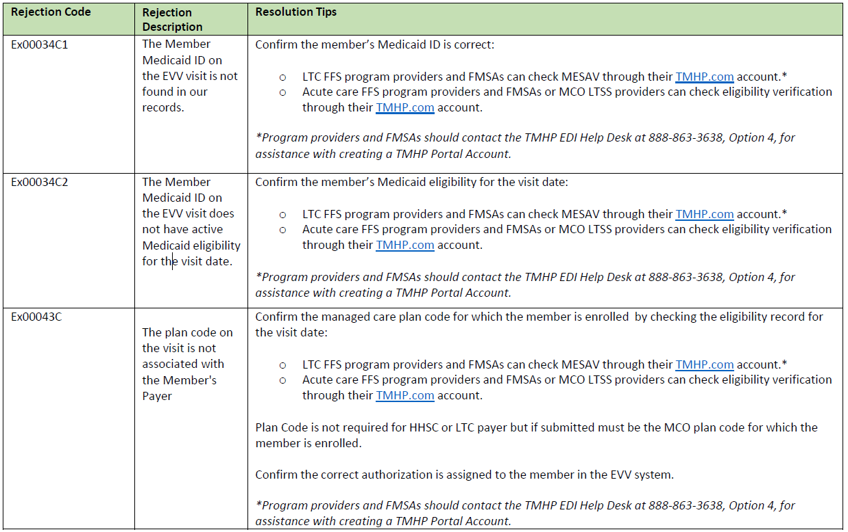
TMHP EVV Visit Rejection Guide – Examples

Slide 8
BCBSTX EVV Website
EVV Webpage for BCBSTX
Four Resource Sections – Policies, Training, Notices and Archives
EVV Visit Maintenance Unlock Request Forms (located on our EVV webpage)
Programs providers and FMSA
CDS Employers
TMHP EVV Contact Information and TMHP Learning Management System.
Department of Health and Human Services Learning Portal.

Slide 9
EVV Contact Information for BCBSTX
BCBSTX_EVV_Questions@bcbstx.com
Provider Customer Service at 877-784-6802
For Service Coordination needs, call 877-301-4394 (TTY 7-1-1)
Information on how to submit a Complaint or Appeal
Sign Up for GovDelivery – Access the most current news and alerts related to EVV

Slide 10
Questions?

