Slide 1
Electronic Visit Verification (EVV) Usage Score
SKSCP-9034-0622

Slide 2
Training Instructions
This is a biannually 30-minute training sessions
Our training is Instructor – led
Training is for Texas Medicaid Providers, FMSAs, and CDS Employers and all have the option to attend. The usage score is a part of their EVV Compliance.
We reference the links to the VMUR forms and where they are located on our website to educate.
Registration is required via Teams Meeting to attend the training and will track training completion for attendees.
Currently no assessment is included in the training.

Slide 3
Overview of Training
Key Terms and Definitions
EVV Policy Handbook – Section 11000 Usage
Visit Transactions
EVV Compliance Job Aids on Usage
EVV Compliance Job Aid for Program Providers and Financial Management Services Agencies (FMSAs) (PDF)
EVV Compliance Job Aid for Consumer Directed Services (CDS) Employers (PDF)
BCBSTX EVV Website and Resources
Form 1718 - EVV Responsiblities and Additional Information
BCBSTX EVV Contact Information

Slide 4
Key Terms and Definitions
Key Term | Definition
Electronic Visit Verification (EVV) | means the documentation and verification of service delivery through an EVV system
21st Century Cures Act | The 21st Century Cures Act is a federal law enacted by the U.S. Congress in December 2016. This law requires all states to use EVV for Medicaid personal care services (PCS) and home health care services (HHCS) requiring an in-home visit that are provided under a State plan or under a waiver of the plan
EVV Compliance Reviews | means a set of standards established by Texas HHSC and MCOs to review on a regular basis to ensure program providers, Financial Management Services Agencies (FMSAs) and Consumer Directed Services (CDS) employers adhere to EVV requirements
EVV Policy Handbook | The Texas Health and Human Services Commission (HHSC) handbook that provides EVV standards and policy requirements
EVV Claims | Program Provider or FMSA must only submit claims for reimbursement once all the visits for the claim line items have been completed and accepted by the EVV Aggregator.
Manual EVV Visits | EVV visits that were manually entered into the EVV Vendor System to correct missing clock in or clock out time for the CDS Employee
Rejected EVV Visits | EVV Visits transactions not accepted by the EVV Aggregator and may require Visit Maintenance
Visit Maintenance | A process that allows edits to certain data elements in an EVV visit transaction within an EVV system

Slide 5
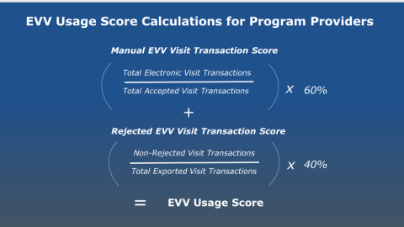
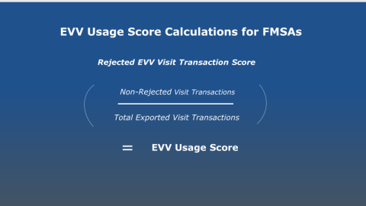
Usage Score – Section 11000
Section 11000 of the EVV Policy Handbook is the section that covers EVV Usage
11010 EVV Usage Score
EVV Usage Score Measures Manually Entered EVV visit transaction and Rejected EVV visit transactions
Program Providers and FMSAs – must achieve and maintain a minimum EVV Usage Score of 80%, each state fiscal year quarter.

Slide 6
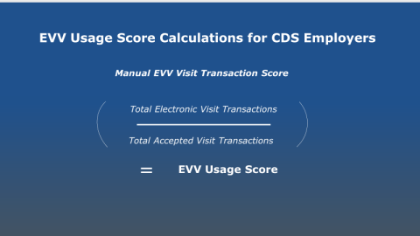
Usage Score – Cont.
CDS Employers must achieve and maintain a minimum EVV Usage Score of 80%, each fiscal year quarter. CDS employer EVV Usage Score requirement is based on service delivery dates. CDS Employers are currently on a Grace Period for FY2022.

Slide 7
Visit Transactions
EVV Policy Section 11020 Manually Entered EVV Visit Transactions
Program Providers and CDS Employers must ensure an HHSC approved method is used to clock in and clock out of the EVV system. When a service provider or CDS Employee does not use an HHSC approved method the visit must be manually entered into the EVV System.
EVV Policy Section 11030 Rejected EVV Visit Transactions
When an EVV visit, transaction is sent to the EVV Aggregator and does not pass all the EVV visit transactions validations, the EVV visit transaction is rejected and sent back to the EVV system to notify the Program Provider, FMSA, or CDS Employer that visit maintenance is required. Each rejected EVV visit transactions counts against the EVV usage score for the Program Providers or FMSA.
EVV Policy Section 11040 EVV Usage Reviews
Gives the MCO’s the review information they must follow, including the schedule and reports used to do the reviews.
EVV Policy Section 11050 Compliance
Gives the MCO’s what actions must be taken if Program Providers, FMSAs, and CDS Employers are not in compliance.

Slide 8
EVV Rejection Visit Table
Edit Number | Data Elements (as applicable) | EVV Visit Rejection Reason
Ex0002C | National Provider Identifier (NPI) | Provider NPI cannot be validated as active for the visit date.
Ex0003C1 | Atypical Provider Identifiers (API) | Provider API cannot be validated as active for the visit date.
Ex00031C | Payer | The Member's Payer on the EVV visit does not match our records for this Member.
Ex00034C1 | Member Medicaid ID | The member Medicaid ID on the EVV visit is not found in our records.
Ex00034C2 | Member Medicaid ID (no active eligibility) | The member Medicaid ID on the EVV visit does not have active Medicaid eligibility for the visit date.
Ex00043C | MCO Member Service Delivery Area (SDA) | The MCO member SDA on the EVV visit does not match the Plan Code associated with the member's payer.
Ex00057C1 | Service Group and Service Code combination | The service group and service code combination on the EVV visit are not eligible for EVV.
Ex00057C2 | Service Group not valid for Provider Number | The service group and Service Code combination on the EVV visit are not valid for the Provider number on the visit.
Ex00057C3 | Member not authorized for Service Group/Service Code combination | The member on the EVV visit is not authorized for this service group/service code on this visit date in our records.
Ex00059C | HCPCS and Modifier combination not eligible for EVV | The HCPCS Code and EVV Modifier combination on the EVV visit is not eligible for EVV.

Slide 9
BCBSTX EVV Website
BCBSTX EVV Webpage - www.bcbstx.com/provider/medicaid/education-and-reference/evv
Four Resource Sections – Policies, Training, Notices, and Archives
Overview of EVV Visit Maintenance Unlock Request (VMUR) forms (located on our EVV webpage)
Programs Providers and FMSA
CDS Employers
TMHP EVV Contact Information & TMHP Learning Management System (LMS)
HHS Learning Portal

Slide 10
BCBSTX EVV Contact Information
BCBSTX_EVV_Questions@bcbstx.com
Provider Customer Service at 1-877-784-6802
For Service Coordination needs, call 1-877-301-4394 (TTY 7-1-1)
Information on how to submit a Complaint or Appeal
Sign Up for GovDelivery – Ensures you will have the most current news and alerts related to EVV

Slide 11
Conclusion
Questions?

